Slide 1
How to Use This Document
This document should be used in conjunction with your other sales-stage-based enablement resources and should largely be used for the propose stage
The Content Navigation Section may be used to jump to a specific customer-facing deliverable based on target user, workflow and sales segment
Slides in the For Professionals section are intended for SMB / VLB customers and are considered customer-ready
Slides in the For Educators and Instructors section are intended for Public Sector / Education customers and are considered customer-ready
Slides in the Notebook Workstation Product Selector and Sell Up Guides section are intended for general decision tree guidance on the ThinkPad P Series and performance Notebook portfolio
2021 Lenovo Internal. All rights reserved.

Slide 2
Recommended SMB PRO Solution Table of Contents
Architecture Engineering & Construction (AEC) Workflows
Mobile-Based Solutions for Engineering and Design
ThinkPad P14s Gen2 Mainstream Ultrabook Workstation for Engineering PROS
ThinkPad P15s Gen2 Mainstream Ultrabook Workstation for Engineering PROS
ThinkPad P15v Gen2 Mainstream Performance Workstation for Engineering PROS
ThinkPad P1 Gen4 Ultraslim Workstation for Engineering PROS
ThinkPad P15 Gen2 Performance Workstation for Engineering PROS
Desktop-Based Solutions for Engineering and Design
ThinkStation P620 Mainstream/Performance Workstation for Engineering PROS
Media & Entertainment (M&E) Workflows
Mobile-Based Solutions:
ThinkPad P1 Gen4 Ultraslim Workstation for Creative PROS
ThinkPad P15 Gen2 Performance Workstation for Creative PROS
Desktop-Based Solutions:
ThinkStation P620 Advanced Performance Workstation for Creative PROS
Software Development & Engineering and Advance Analytics Workflows
Mobile-Based Solutions:
ThinkPad P14s Gen2 Mainstream Ultrabook Workstation for Software Development PROS
ThinkPad P15s Gen2 Mainstream Ultrabook Workstation for Software Development PROS
ThinkPad P15v Gen2 Portable Workstation for Software Development PROS
ThinkPad P1 Gen4 Ultraslim Premium Workstation for Software Development PROS
ThinkPad P15 Gen2 Performance Workstation for Software Development PROS
Desktop-Based Solutions:
ThinkStation P620 Advanced Performance Data Science Tower Workstation for Data PROS
2021 Lenovo Internal. All rights reserved.

Slide 3
Recommended SMB EDU Solution Table of Contents
Architecture Engineering & Construction (AEC) Curricula
Mobile-Based Solutions for Engineering and Design
ThinkPad P14s Gen2 Mainstream Ultrabook Workstation for Engineering STUDENTS & INSTRUCTORS
ThinkPad P15s Gen2 Mainstream Ultrabook Workstation for Engineering STUDENTS & INSTRUCTORS
ThinkPad P15v Gen2 Portable Workstation for Engineering STUDENTS & INSTRUCTORS
ThinkPad P1 Gen4 Ultraslim Workstation for Engineering STUDENTS & INSTRUCTORS
ThinkPad P15 Gen2 Performance Workstation for Engineering STUDENTS & INSTRUCTORS
Desktop-Based Solutions for Engineering and Design
ThinkStation P620 Performance Workstation for Engineering STUDENTS & INSTRUCTORS
Media & Entertainment (M&E) Curricula
Mobile-Based Solutions:
ThinkPad P1 Gen4 Ultraslim Workstation for Creative Arts STUDENTS & INSTRUCTORS
ThinkPad P15 Gen2 Performance Workstation for Creative Arts STUDENTS & INSTRUCTORS
Desktop-Based Solutions:
ThinkStation P620 Performance Workstation for Creative Arts STUDENTS & INSTRUCTORS
Software Development & Engineering and Advance Analytics Curricula
Mobile-Based Solutions:
ThinkPad P15v Gen2 Mainstream Performance Workstation for Computer Science & Software Development STUDENTS & INSTRUCTORS
ThinkPad P1 Gen4 Ultraslim Premium Workstation for Computer Science & Software Development STUDENTS & INSTRUCTORS
ThinkPad P15 Gen2 Performance Workstation for Computer Science & Software Development STUDENTS & INSTRUCTORS
Desktop-Based Solutions:
ThinkStation P620 Performance Workstation for Computer Science & Software Development STUDENTS & INSTRUCTORS
2021 Lenovo Internal. All rights reserved.

Slide 4
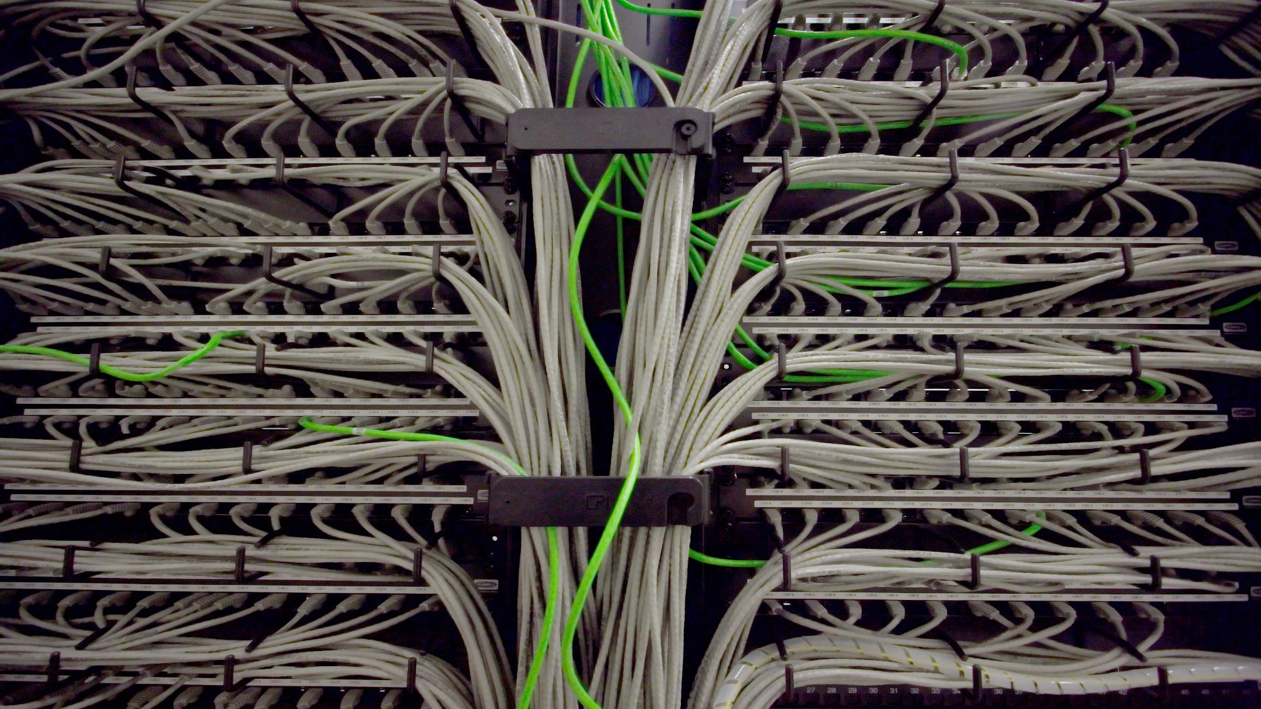
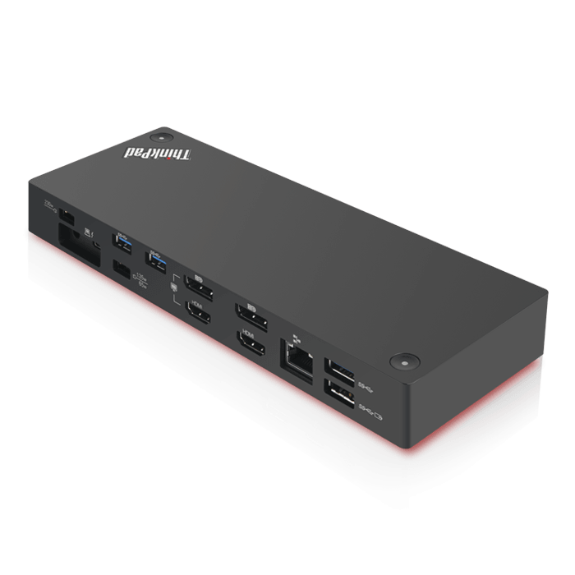
ThinkPad P14s Gen2 for Engineering Professionals
A powerful and lightweight mobile workstation, designed to meet the needs of highly mobile architects, interior designers, aerospace, civil engineers, and construction managers
Most portable 14” mobile workstation at just over 3 pounds
Immersive A/V experience with Dolby® Audio™ Premium sound
All-new updated NVIDIA Turing-based graphics for lite duty CAD
Free-of-charge pro app acceleration in Lenovo Performance Tuner
All-day battery up to 10 hours with Rapid Charge technology
 | Mainstream | Recommended
Part Number | 20VX009JUS* | 20VX0097US*
List Price | $2,229 | $2,799
Processor | Intel® Core™ i7-1185G7 vPro (4c) | Intel® Core™ i7-1185G7 vPro (4c)
Graphics | NVIDIA® T500 4GB GDDR6 | NVIDIA® T500 4GB GDDR6
Memory | 16GB (16GB soldered + 1x open DIMM slot) DDR4 3200MHz | 32GB (16GB soldered + 16GB DIMM) DDR4 3200MHz
Storage | 512GB M.2 PCIe NVMe | 1TB M.2 PCIe NVMe
Display | 14” FHD IPS 300nit, 45% NTSC Color, HD Camera | 14” UHD IPS 500nit, Factory-Color-Calibrated 100% Adobe Color, Dolby Vision HDR, IR Camera
Warranty | 3 Year Premier Support | 3 Year Premier Support
ISV-certified with the most popular professional applications to accelerate business results:
3 Year Accidental Damage Protection
5PS0V07049 | $129 MSRP
ThinkVision
P27h
61E9GAR6US | $504 MSRP
Thunderbolt Gen2 Dock
40AN0135US | $320 MSRP

Slide 5
ThinkPad P15s Gen2 for Engineering Professionals
On-the-go, all-day performance in a value package for architects, interior designers, building, structural, aerospace, civil engineers, and facilities & construction managers
Ultrabook workstation with award-winning keyboard and number pad
Immersive A/V experience with Dolby® Audio™ Premium sound
All-new updated NVIDIA Turing-based graphics for lite duty CAD
Free-of charge app acceleration with Lenovo Performance Tuner
All-day battery up to 10 hours with Rapid Charge technology
 | Mainstream | Recommended
Part Number | 20W60087US* | 20W60088US*
List Price | $2,119 | $2,849
Processor | Intel® Core™ i7-1185G7 vPro (4c) | Intel® Core™ i7-1185G7 vPro (4c)
Graphics | NVIDIA® T500 4GB GDDR6 | NVIDIA® T500 4GB GDDR6
Memory | 16GB (16GB soldered + 1x open DIMM slot) DDR4 3200MHz | 32GB (16GB soldered + 16GB DIMM) DDR4 3200MHz
Storage | 512GB M.2 PCIe NVMe | 1TB M.2 PCIe NVMe
Display | 15.6” FHD IPS 300nit, 45% NTSC Color, HD Camera | 15.6” UHD IPS 500nit, Factory-Color-Calibrated 100% Adobe Color, IR Camera
Warranty | 3 Year Premier Support | 3 Year Premier Support
ISV-certified with the most popular professional applications to accelerate business results:
3 Year Accidental Damage Protection
5PS0V07049 | $129 MSRP
ThinkVision
P27h
61E9GAR6US | $504 MSRP
Thunderbolt Gen2 Dock
40AN0135US | $320 MSRP

Slide 6
ThinkPad P15v Gen 2 for Engineering Professionals
Remote Workstation-Ready!
A brilliant visual workspace and exceptional performance at an accessible price point for architects, interior designers, civil engineers, facilities and construction managers
“Increased flexibility within the 15-inch space…for professional workflows.”
- Hexus
11th Gen Intel® Core™ CPUs with AI-based intelligent performance
Now available with up to NVIDIA RTX™ A2000
Available stunning 15.6” IPS 4K UHD display with color calibration
Ultra-Performance mode to throttle your workflow to the redline
High-capacity battery with Rapid Charge technology
 | Mainstream | Recommended
Part Number | 21A90036US* | 21A9002XUS*
List Price | $2,019 | $2,799
Processor | Intel® Core™ i7-11850H vPro (8c) | Intel® Core™ i7-11850H vPro (8c)
Graphics | NVIDIA® T600 4GB GDDR6 | NVIDIA RTX™ A2000 4GB GDDR6
Memory | 16GB (1x16GB) DDR4 3200MHz | 32GB (1x32GB) DDR4 3200MHz
Storage | 512GB M.2 PCIe NVMe | 1TB M.2 PCIe NVMe
Display | 15.6” FHD IPS 300nit, 45% NTSC Color, IR Camera | 15.6” FHD IPS 300nit, 45% NTSC Color, IR Camera
Warranty | 3 Year Premier Support | 3 Year Premier Support
ISV-certified with the most popular professional applications to accelerate business results:
3 Year Accidental Damage Protection
5PS0V07049 | $129 MSRP
ThinkVision
P27q
61EAGAR6US | $404 MSRP
Thunderbolt 4 Workstation Dock
40B00300US | $419 MSRP

Slide 7
ThinkPad P1 Gen4 for Engineering Professionals
Remote Workstation-Ready!
On-the-go performance in a premium package for architects, interior designers, aerospace, civil engineers, and construction managers
11th Gen Intel® Core™ CPUs with AI-based intelligent performance
Leveled-up 3D graphics performance now up to NVIDIA RTX™ A5000
Premium user experience with Dolby Atmos® sound and Dolby Vision™
Durable MIL-STD testing and market-leading reliability
Ultra-Performance mode to throttle your workflow to the redline
“An impressive choice for design or engineering PROS seeking a road-worthy workstation.”
-PC Mag
 | Mainstream | Recommended
Part Number | 20Y3003BUS* | 20Y3003CUS*
List Price | $2,569 | $2,939
Processor | Intel® Core™ i7-11850H vPro (8C) | Intel® Core™ i7-11850H vPro (8c)
Graphics | NVIDIA RTX™ A2000 4GB GDDR6 | NVIDIA RTX™ A2000 4GB GDDR6
Memory | 16GB (1x16GB) DDR4 3200MHz | 32GB (1x32GB) DDR4 3200MHz
Storage | 512GB M.2 PCIe Gen4 NVMe | 1TB M.2 PCIe Gen4 NVMe
Display | 16" WQXGA (2560x1600) “QHD+” IPS 400nit, 100% sRGB Color, IR Camera | Touch 16.0" WQUXGA (3840x2400) “UHD+” IPS 600nit, Factory-Color-Calibrated 100% Adobe Color, Dolby Vision HDR, IR Camera
Warranty | 3 Year Premier Support | 3 Year Premier Support
ISV-certified with the most popular professional applications to accelerate business results:
3 Year Accidental Damage Protection
5PS0V07049 | $129 MSRP
ThinkVision
P27q
61EAGAR6US | $404 MSRP
Thunderbolt 4 Workstation Dock
40B00300US | $419 MSRP
Notes:
This is compared to the P1 Gen2, using the Sysmark test

Slide 8
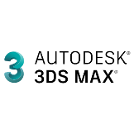
ThinkPad P15 Gen2 for Engineering Professionals
Remote Workstation-Ready!
On-the-go, high performance visual computing for architects, interior designers, building, structural, aerospace & civil engineers, and facilities & construction managers
“…obliterates big workflows like nobody's business.”
-PC Mag
11th Gen Intel® Core™ CPUs with AI-based intelligent performance
Available XR-ready NVIDIA RTX™ A5000 to transcend design review
Durable MIL-STD testing and market-leading reliability
Ultra-Performance mode to throttle your workflow to the redline
Free-of-charge Lenovo Performance Tuner to optimize workflow
 | Mainstream | Recommended
Part Number | 20YQ0042US* | 20YQ0030US*
List Price | $2,459 | $3,229
Processor | Intel® Core™ i7-11850H vPro (8c) | Intel® Core™ i7-11850H vPro (8c)
Graphics | NVIDIA® T1200 4GB GDDR6 | NVIDIA RTX™ A3000 6GB GDDR6
Memory | 16GB (1x16GB) DDR4 3200MHz | 32GB (2x16GB) DDR4 3200MHz
Storage | 512GB M.2 PCIe NVMe | 1TB M.2 PCIe NVMe
Display | 15.6" FHD (1920x1080) IPS 500nit, 100% sRGB Color, Dolby Vision HDR | 15.6" FHD (1920x1080) IPS 500nit, 100% sRGB Color, Dolby Vision HDR
Warranty | 3 Year Premier Support | 3 Year Premier Support
ISV-certified with the most popular professional applications to accelerate business results:
3 Year Accidental Damage Protection
5PS0V07049 | $129 MSRP
ThinkVision
P27q
61EAGAR6US | $404 MSRP
Thunderbolt 4 Workstation Dock
40B00300US | $419 MSRP

Slide 9
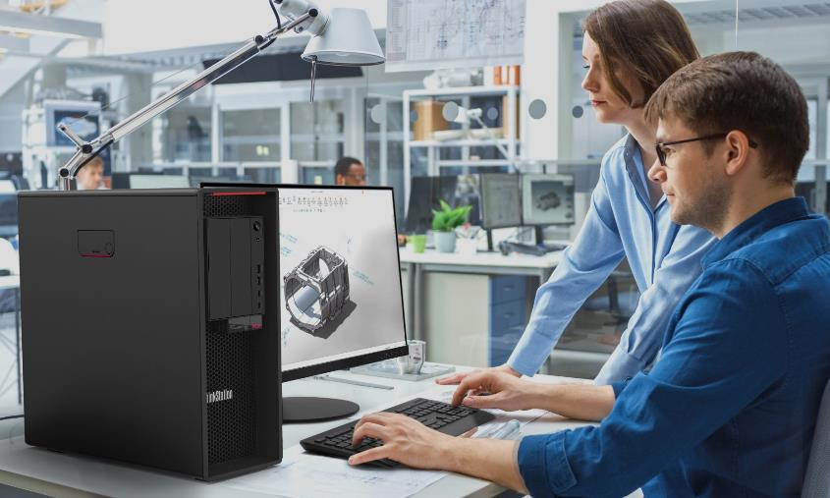
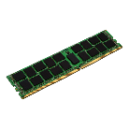
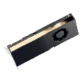
ThinkStation P620 for Engineering Professionals
Remote Workstation-Ready!
Unprecedented levels of power, performance and flexibility in a single socket CPU platform for architects, interior designers, engineers, and facilities & construction managers
Tool-less, modular design with FLEX features for versatile IO options
AMD Ryzen™ Threadripper™ PRO CPUs with up to 64 cores
Base clock 14% higher than similar core density competitor CPUs
Available Ampere-based NVIDIA® RTX™ graphics with 2nd gen RT Cores
Up to 1TB octa-channel memory
“The ThinkStation P620 throws in everything you could ever need, and then some.”
- Windows Central
 | Mainstream | Recommended
Part Number | 30E000DQUS* | 30E000DYUS*
List Price | $2,949 | $4,739
Processor | AMD Ryzen™ Threadripper™ PRO 3945WX 12c 4.0GHz | AMD Ryzen™ Threadripper™ PRO 3955WX 16c 3.9GHz
Graphics | NVIDIA® T1000 4GB GDDR6 | NVIDIA RTX™ A4000 16GB GDDR6
Memory | 32GB (2x16GB) DDR4 3200MHz RDIMM ECC | 64GB DDR4 (4x32GB) 3200MHz RDIMM ECC
Storage | 1TB M.2 PCIe Gen4 NVMe | 1TB M.2 PCIe Gen4 NVMe
Power Supply | 1000W | 1000W
Warranty | 3 Year Premier Support | 3 Year Premier Support
ISV-certified with the most popular professional applications to accelerate business results:
16GB 3200MHz ECC RAM
4X70Z90847 | $200 MSRP
ThinkVision
P27q
61EAGAR6US | $404 MSRP
NVIDIA® RTX™ A5000 16GB
4X61D97085 | $2,999 MSRP

Slide 10
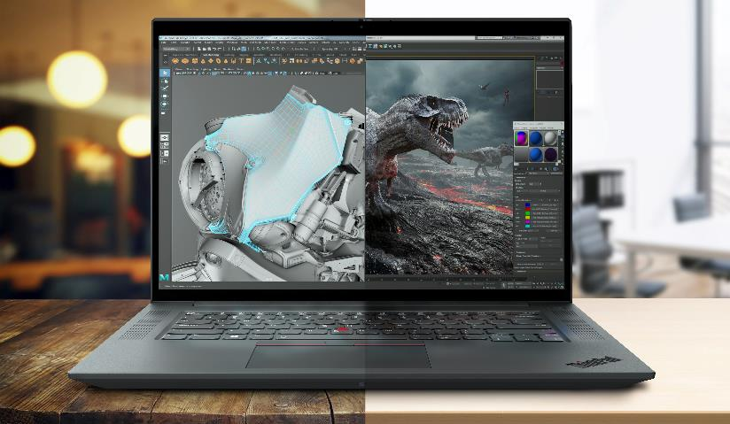
ThinkPad P1 Gen4 for Creative Professionals
Remote Workstation-Ready!
On-the-go performance in a premium package for animators, editors, cinematographers, broadcasters, and digital artists
11th Gen Intel® Core™ CPUs with AI-based intelligent performance
Leveled-up 3D graphics performance now up to NVIDIA RTX™ A5000
Premium user experience with Dolby Atmos® sound and Dolby Vision™
Durable MIL-STD testing and market-leading reliability
Stunning UHD+ HDR option with Wacom® support for intuitive drafting
“A winner for traveling design PROS or content creators.”
- PC Mag
 | Mainstream | Recommended
Part Number | 20Y3003BUS* | 20Y3003TUS*
List Price | $2,569 | $4,199
Processor | Intel® Core™ i7-11850H vPro (8C) | Intel® Core™ i9-11950H vPro (8c)
Graphics | NVIDIA RTX™ A2000 4GB GDDR6 | NVIDIA GeForce RTX 3080 16GB GDDR6
Memory | 16GB (1x16GB) DDR4 3200MHz | 32GB (1x32GB) DDR4 3200MHz
Storage | 512GB M.2 PCIe NVMe | 1TB M.2 PCIe NVMe
Display | 16" WQXGA (2560x1600) “QHD+” IPS 400nit Anti-glare, 100% sRGB Color | Touch 16.0" WQUXGA (3840x2400) “UHD+” IPS 600nit, Factory-Color-Calibrated 100% Adobe Color, Dolby Vision HDR, IR Camera
Warranty | 3 Year Premier Support | 3 Year Premier Support
ISV-certified* with the most popular professional applications to accelerate business results:
3 Year Accidental Damage Protection
5PS0V07049 | $129 MSRP
ThinkVision
P27q
61EAGAR6US | $404 MSRP
Thunderbolt 4 Workstation Dock
40B00300US | $419 MSRP
*GeForce-based systems NOT ISV-certified

Slide 11
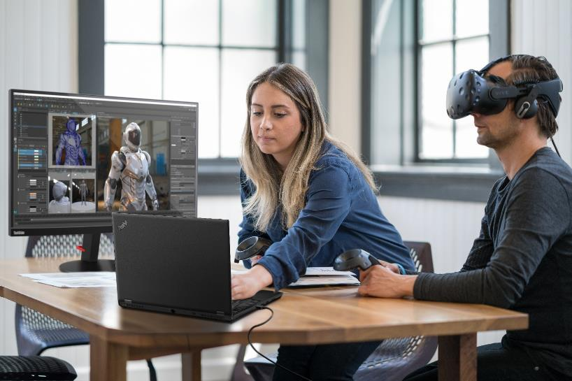
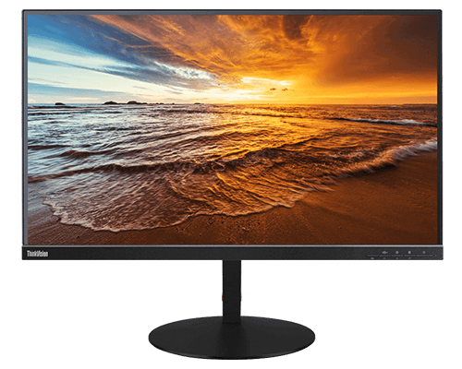
ThinkPad P15 Gen2for Creative Professionals
Remote Workstation-Ready!
On-the-go high performance visual computing for animators, editors, cinematographers, broadcasters, and digital artists
“…obliterates big workflows like nobody's business.”
-PC Mag
11th Gen Intel® Core™ CPUs with AI-based intelligent performance
Available XR-ready NVIDIA RTX™ A5000 to transcend design review
Durable MIL-STD testing and market-leading reliability
Ultra-Performance mode to throttle your workflow to the redline
Free-of-charge Lenovo Performance Tuner to optimize workflow
 | Mainstream | Recommended
Part Number | 20YQ003AUS* | 20YQ0045US
List Price | $2,619 | $4,129
Processor | Intel® Core™ i7-11850H vPro (8C) | Intel® Core™ i9-11950H vPro (8C)
Graphics | NVIDIA RTX™ A2000 4GB GDDR6 | NVIDIA RTX™ A4000 8GB GDDR6
Memory | 16GB (1x16GB) DDR4 3200MHz | 32GB (2x16GB) DDR4 3200MHz
Storage | 512GB M.2 PCIe NVMe | 1TB M.2 PCIe NVMe
Display | 15.6" FHD (1920x1080) IPS 500nit, 100% sRGB Color, Dolby Vision HDR | Touch 15.6" UHD (3840x2160) OLED 400nit, Factory-Color-Calibrated 100% DCI-P3 Color, Dolby Vision HDR
Warranty | 3 Year Premier Support | 3 Year Premier Support
ISV-certified with the most popular professional applications to accelerate business results:
3 Year Accidental Damage Protection
5PS0V07049 | $129 MSRP
ThinkVision
P32u
61C1RAR2US | $1,384 MSRP
Thunderbolt 4 Workstation Dock
40B00300US | $419 MSRP

Slide 12
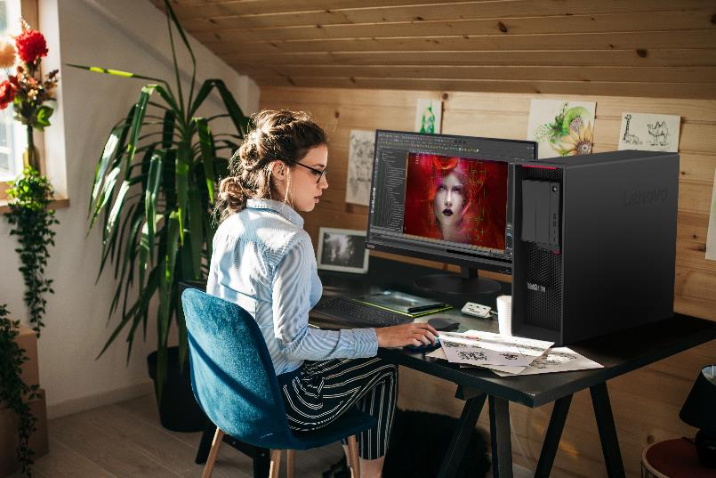
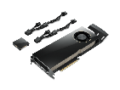
ThinkStation P620 for Creative Professionals
Remote Workstation-Ready!
Unprecedented levels of power, performance and flexibility in a single socket CPU platform for animators, editors, broadcasters, and digital artists
Tool-less, modular design with FLEX features for versatile IO options
AMD Ryzen™ Threadripper™ PRO CPUs with up to 64 cores
Multi-threaded performance up to 39% higher than dual CPU competitors
Latest Ampere-based NVIDIA® RTX™ graphics with 2nd gen RT Cores
Up to 1TB octa-channel memory
 | Mainstream | Recommended
Part Number | 30E000DPUS* | 30E00097US
List Price | $3,979 | $11,589
Processor | AMD Ryzen™ Threadripper™ PRO 3945WX 12c 4.0GHz | AMD Ryzen™ Threadripper™ PRO 3975WX 32c, 3.5GHz
Graphics | NVIDIA RTX™ A4000 16GB GDDR6 | NVIDIA® RTX™ A6000 48GB GDDR6
Memory | 32GB DDR4 (2x32GB) 3200MHz RDIMM ECC | 64GB (4x16GB) DDR4 3200MHz ECC RDIMM
Storage | 1TB M.2 PCIe Gen4 NVMe | 1TB M.2 PCIe Gen4 NVMe
Power Supply | 1000W | 1000W
Warranty | 3 Year Premier Support | 3 Year Premier Support
“The ThinkStation P620 throws in everything you could ever need, and then some.”
-Windows Central
ISV-certified with the most popular professional applications to accelerate business results:
16GB 3200MHz ECC RAM
4X70Z90847 | $200 MSRP
ThinkVision
P32u
61C1RAR2US | $1,384 MSRP
NVIDIA® RTX™ A6000 48GB
4X61D17227 | $5,999 MSRP

Slide 13
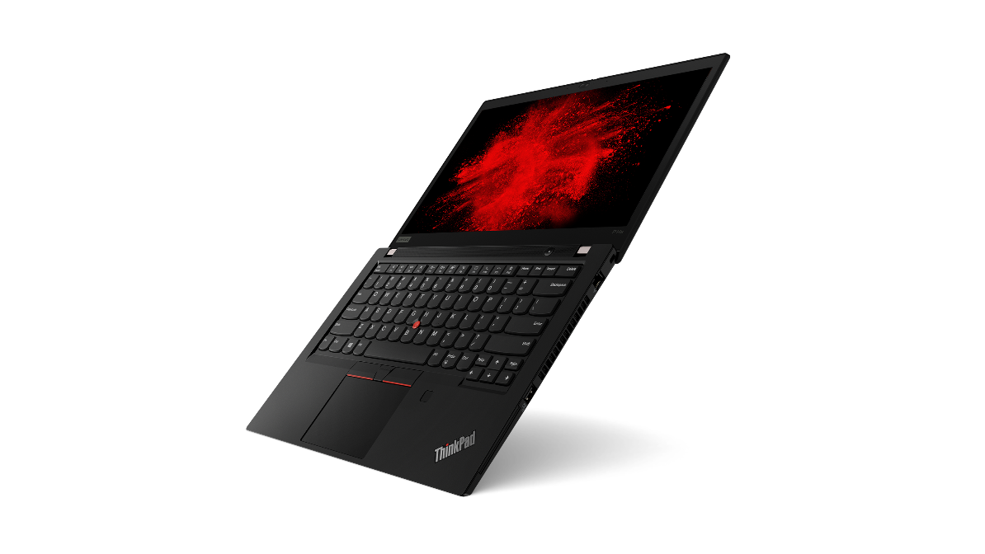
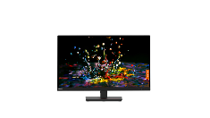
ThinkPad P14s Gen2 for Software Development and Analytics
On-the-go, all-day performance in an ultraportable package for data engineers, data scientists, programmers, software engineers, and application & systems developers
“…a compact solution for those who want as much power as possible in a compact form.”
-Dealelectronic
Most portable 14” mobile workstation at just over 3 pounds
Durable MIL-STD testing and market-leading reliability
Support for up to 48GB system memory
All-day battery up to 10 hours with Rapid Charge technology
Diverse and holistic Linux support
 | Mainstream | Recommended
Part Number | 20VX009JUS* | 20VX008UUS*
List Price | $2,229 | $2,599
Processor | Intel® Core™ i7-1185G7 vPro (4c) | Intel® Core™ i7-1185G7 vPro (4c)
Graphics | NVIDIA® T500 4GB GDDR6 | NVIDIA® T500 4GB GDDR6
Memory | 16GB (16GB soldered + 1x open DIMM slot) DDR4 3200MHz | 32GB (16GB soldered + 16GB DIMM) DDR4 3200MHz
Storage | 512GB M.2 PCIe NVMe | 1TB M.2 PCIe NVMe
Display | 14” FHD IPS 300nit, 45% NTSC Color, HD Camera | 14” FHD IPS 300nit, 45% NTSC Color, HD Camera
Warranty | 3 Year Premier Support | 3 Year Premier Support
3 Year Accidental Damage Protection
5PS0V07049 | $129 MSRP
ThinkVision
P32p
62A2GAR2US | $1,034 MSRP
Thunderbolt Gen2 Dock
40AN0135US | $320 MSRP

Slide 14
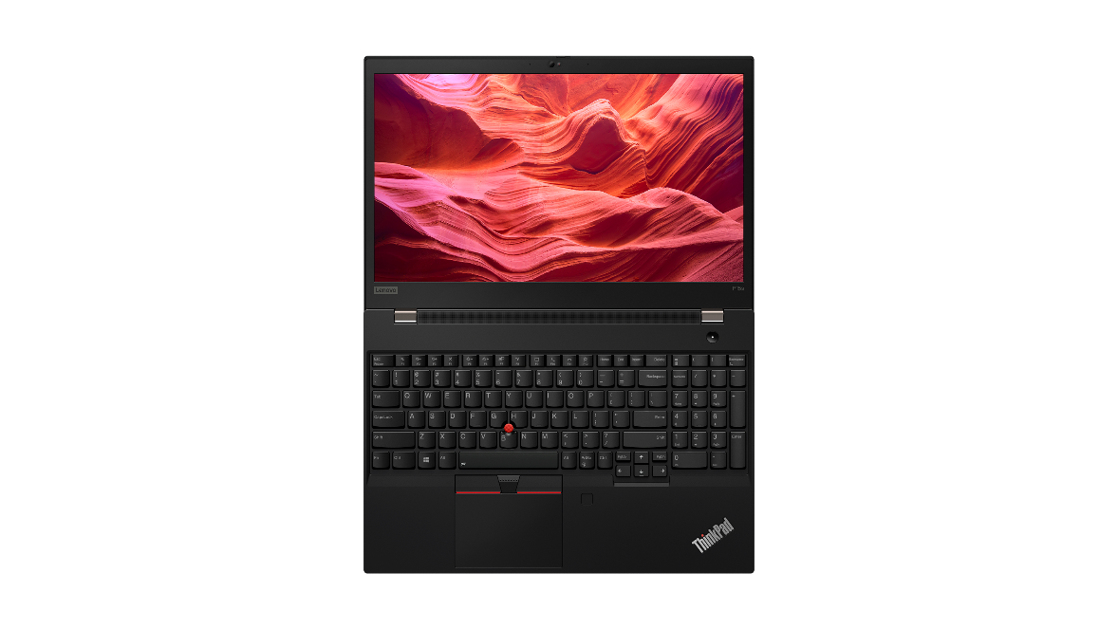
ThinkPad P15s Gen2 for Software Development and Analytics
On-the-go, all-day performance in a value package for data engineers, data scientists, programmers, software engineers, and application & systems developers
Editor’s Choice Award by Laptopmedia.com
Ultrabook workstation with award-winning keyboard and number pad
Durable MIL-STD testing and market-leading reliability
Support for Support for up to 48GB system memory
All-day battery up to 10 hours with Rapid Charge technology
Diverse and holistic Linux support
 | Mainstream | Recommended
Part Number | 20W60087US* | 20W6008CUS*
List Price | $2,119 | $2,599
Processor | Intel® Core™ i7-1185G7 vPro (4c) | Intel® Core™ i7-1185G7 vPro (4c)
Graphics | NVIDIA® T500 4GB GDDR6 | NVIDIA® T500 4GB GDDR6
Memory | 16GB (16GB soldered + 1x open DIMM slot) DDR4 3200MHz | 32GB (16GB soldered + 16GB DIMM) DDR4 3200MHz
Storage | 512GB M.2 PCIe NVMe | 1TB M.2 PCIe NVMe
Display | 15.6” FHD IPS 300nit, 45% NTSC Color, HD Camera | 15.6” FHD IPS 300nit, 45% NTSC Color, HD Camera
Warranty | 3 Year Premier Support | 3 Year Premier Support
3 Year Accidental Damage Protection
5PS0V07049 | $129 MSRP
ThinkVision
P32p
62A2GAR2US | $1,034 MSRP
Thunderbolt Gen2 Dock
40AN0135US | $320 MSRP

Slide 15
ThinkPad P15v Gen2 for Software Development and Analytics
Remote Workstation-Ready!
A wallet-friendly, computationally powerful workstation for data engineers, data scientists, programmers, software engineers, and application & systems developers
“Increased flexibility within the 15-inch space…for professional workflows.”
- Hexus
11th Gen Intel® Core™ CPUs with AI-based intelligent performance
Now available with up to NVIDIA RTX™ A2000
Available stunning 15.6” IPS 4K UHD display with color calibration
Ultra-Performance mode to throttle your workflow to the redline
Diverse and holistic Linux support
 | Mainstream | Recommended
Part Number | 21A90036US* | 21A9002XUS*
List Price | $2,019 | $2,799
Processor | Intel® Core™ i7-11850H vPro (8c) | Intel® Core™ i9-11950H (8c)
Graphics | NVIDIA® T600 4GB GDDR6 | NVIDIA RTX™ A2000 4GB GDDR6
Memory | 16GB (1x16GB) DDR4 3200MHz | 32GB (1x32GB) DDR4 3200MHz
Storage | 512GB M.2 PCIe NVMe | 1TB M.2 PCIe NVMe
Display | 15.6" FHD (1920x1080) IPS 300nit, 45% NTSC Color, IR Camera | 15.6" FHD (1920x1080) IPS 300nit, 45% NTSC Color, IR Camera
Warranty | 3 Year Premier Support | 3 Year Premier Support
3 Year Accidental Damage Protection
5PS0V07049 | $129 MSRP
ThinkVision
P32p
62A2GAR2US | $1,034 MSRP
Thunderbolt 4 Workstation Dock
40B00300US | $419 MSRP

Slide 16
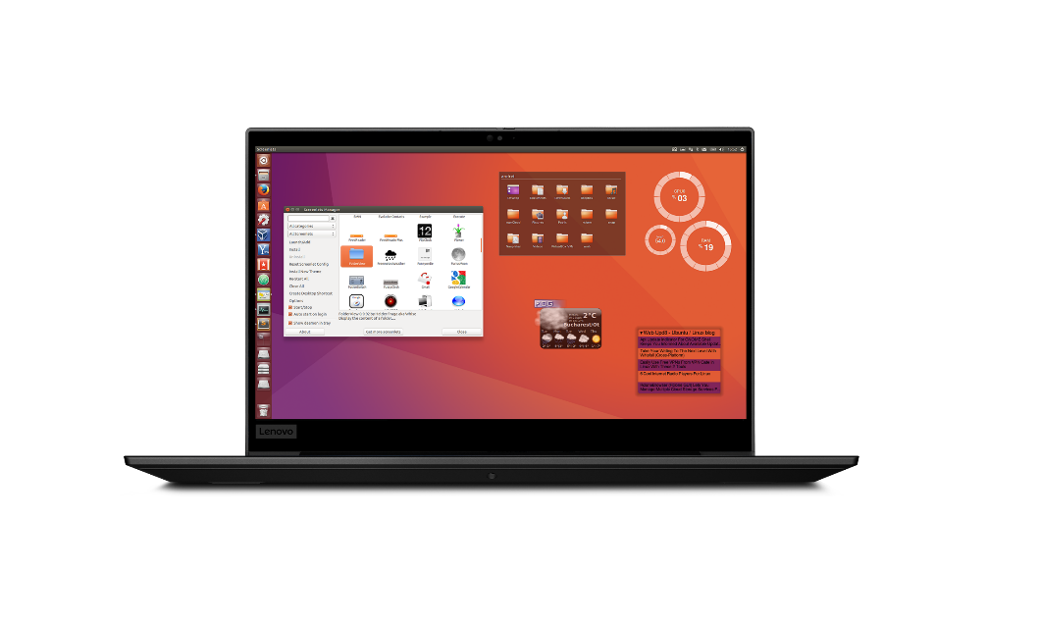
ThinkPad P1 Gen4 for Software Development and Analytics
Remote Workstation-Ready!
On-the-go performance in a premium package for data engineers, data scientists, programmers, software engineers, and application & systems developers
11th Gen Intel® Core™ CPUs with AI-based intelligent performance
Leveled-up 3D graphics performance now up to NVIDIA RTX™ A5000
Durable MIL-STD testing and market-leading reliability
Ultra-Performance mode to throttle your workflow to the redline
Diverse and holistic Linux support
 | Mainstream | Recommended
Part Number | 20Y3005WUS | 20Y30048US
List Price | $2,369 | $5,189
Processor | Intel® Core™ i7-11850H vPro (8C) | Intel® Core™ i9-11950H (8C)
Graphics | Integrated Intel® UHD Graphics | NVIDIA RTX™ A5000 16GB GDDR6
Memory | 16GB (1x16GB) DDR4 3200MHz | 32GB (1x32GB) DDR4 3200MHz
Storage | 512GB M.2 PCIe NVMe | 1TB M.2 PCIe NVMe
Display | 16" WQXGA (2560x1600) “QHD+” IPS 400nit, 100% sRGB Color, IR Camera | 16" WQXGA (2560x1600) “QHD+” IPS 400nit, 100% sRGB Color, IR Camera
Warranty | 3 Year Premier Support | 3 Year Premier Support
“Best laptop for programming in 2020.”
-Creative Bloq
3 Year Accidental Damage Protection
5PS0V07049 | $129 MSRP
ThinkVision
P32p
62A2GAR2US | $1,034 MSRP
Thunderbolt 4 Workstation Dock
40B00300US | $419 MSRP

Slide 17
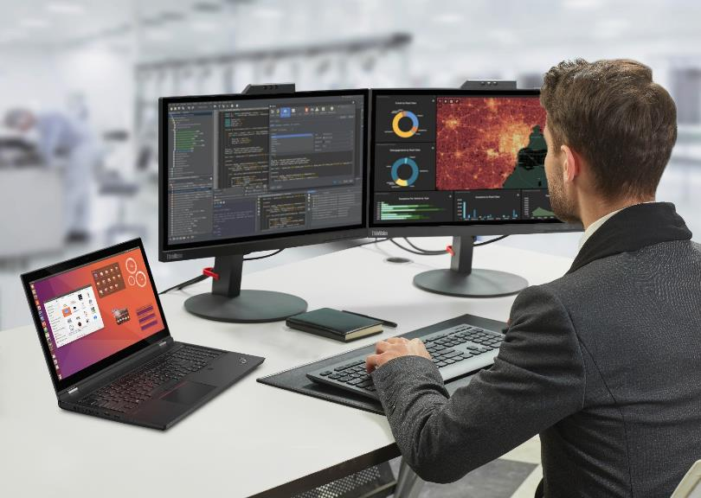
ThinkPad P15 Gen2 for Software Development and Analytics
Remote Workstation-Ready!
On-the-go high performance client computing for data engineers, data scientists, programmers, software engineers, and application & systems developers
“…obliterates big workflows like nobody's business.”
-PC Mag
11th Gen Intel® Core™ CPUs with AI-based intelligent performance
Durable MIL-STD testing and market-leading reliability
Up to 128GB total system memory and 4TB PCIe NVMe storage
Free-of-charge Lenovo Performance Tuner to optimize workflow
Diverse and holistic Linux support
 | Mainstream | Recommended
Part Number | 20YQ0042US* | 20YQ003NUS*
List Price | $2,459 | $3,849
Processor | Intel® Core™ i7-11850H vPro (8c) | Intel® Core™ i9-11950H vPro (8c)
Graphics | NVIDIA® T1200 4GB GDDR6 | NVIDIA RTX™ A4000 8GB GDDR6
Memory | 16GB (1x16GB) DDR4 3200MHz | 32GB (2x16GB) DDR4 3200MHz
Storage | 512GB M.2 PCIe NVMe | 1TB M.2 PCIe NVMe
Display | 15.6" FHD (1920x1080) IPS 500nit, 100% sRGB Color, Dolby Vision HDR, IR Camera | 15.6" FHD (1920x1080) IPS 500nit, 100% sRGB Color, Dolby Vision HDR, IR Camera
Warranty | 3 Year Premier Support | 3 Year Premier Support
3 Year Accidental Damage Protection
5PS0V07049 | $129 MSRP
ThinkVision
P32p
62A2GAR2US | $1,034 MSRP
Thunderbolt 4 Workstation Dock
40B00300US | $419 MSRP

Slide 18
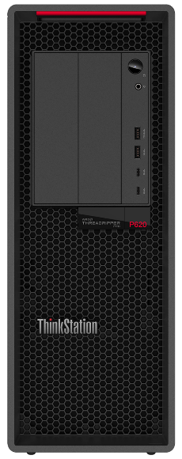
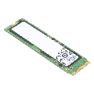
ThinkStation P620 for Software Development and Analytics
Remote Workstation-Ready!
Unprecedented levels of power, performance and flexibility in a single socket CPU platform for software, data engineers, and application & systems developers
“The ThinkStation P620 throws in everything you could ever need, and then some.”
- Windows Central
Tool-less, modular design with FLEX features for versatile IO options
AMD Ryzen™ Threadripper™ PRO CPUs with up to 64 cores
Multi-threaded performance up to 39% higher than dual CPU platforms
Latest NVIDIA RTX™ GPUs with 3rd gen Tensor Cores
Up to 1TB octa channel system memory
 | Mainstream | Recommended
Part Number | 30E000DQUS* | 30E000ARUS*
List Price | $2,949 | $5,939
Processor | AMD Ryzen™ Threadripper™ PRO 3945WX 12c 4.0GHz | AMD Ryzen™ Threadripper™ PRO 3955WX 16c, 3.9GHz
Graphics | NVIDIA® T1000 4GB GDDR6 | NVIDIA® RTX™ A5000 24GB GDDR6
Memory | 32GB (2x16GB) DDR4 3200MHz RDIMM ECC | 64GB (4x16GB) DDR4 3200MHz ECC RDIMM
Storage | 1TB M.2 PCIe Gen4 NVMe | 1TB M.2 PCIe Gen4 NVMe
Power Supply | 1000W | 1000W
Warranty | 3 Year Premier Support | 3 Year Premier Support
16GB 3200MHz ECC RAM
4X70Z90847 | $200 MSRP
ThinkVision
P32p
62A2GAR2US | $1,034 MSRP
2TB M.2 PCIe Gen4 NVMe SSD
4XB1D04758 | $699 MSRP

Slide 19
ThinkPad P14s Gen2 for Engineering Education
On-the-go, all-day performance in an ultraportable package for technical educators and mechanical, structural, aerospace, civil, and industrial engineering students
Most portable 14” mobile workstation at just over 3 pounds
Immersive A/V experience with Dolby® Audio™ Premium sound
All-new updated NVIDIA Turing-based graphics for lite duty CAD
Free-of-charge pro app acceleration in Lenovo Performance Tuner
All-day battery up to 15 hours with Rapid Charge technology
“…a compact solution for those who want as much power as possible in a compact form.”
-Dealelectronic
 | Mainstream | Recommended
Part Number | 20VX009HUS | 20VX008XUS*
List Price | $1,859 | $2,029
Processor | Intel® Core™ i5-1145G7 vPro (4c) | Intel® Core™ i7-1165G7 (4c)
Graphics | NVIDIA® T500 4GB GDDR6 | NVIDIA® T500 4GB GDDR6
Memory | 16GB (8GB soldered + 8GB DIMM) DDR4 3200MHz | 16GB (16GB soldered + 1x open DIMM slot) DDR4 3200MHz
Storage | 256GB M.2 PCIe NVMe | 512GB M.2 PCIe NVMe
Display | 14” FHD IPS 300nit, 45% NTSC Color, HD Camera | Touch 14” FHD IPS 300nit, 45% NTSC Color, HD Camera
Warranty | 3 Year Premier Support | 3 Year Premier Support
ISV-certified with the most popular professional applications to accelerate optimal learning outcomes:
3 Year Accidental Damage Protection
5PS0V07049 | $129 MSRP
ThinkVision
P24q
61F5GAR1US | $304 MSRP
Thunderbolt Gen2 Dock
40AN0135US | $320 MSRP

Slide 20
ThinkPad P15s Gen2 for Engineering Education
On-the-go, all-day performance in a value package for technical educators and mechanical, structural, aerospace, civil, and industrial engineering students
Editor’s Choice Award of Laptopmedia.com
Ultrabook workstation with award-winning keyboard and number pad
Immersive A/V experience with Dolby® Audio™ Premium sound
All-new updated NVIDIA Turing-based graphics for lite duty CAD
Free-of-charge pro app acceleration in Lenovo Performance Tuner
All-day battery up to 15 hours with Rapid Charge technology
 | Mainstream | Recommended
Part Number | 20W6008DUS* | 20W60085US
List Price | $1,969 | $2,029
Processor | Intel® Core™ i5-1145G7 vPro (4c) | Intel® Core™ i7-1165G7 (4c)
Graphics | NVIDIA® T500 4GB GDDR6 | NVIDIA® T500 4GB GDDR6
Memory | 16GB (8GB soldered + 8GB DIMM) DDR4 3200MHz | 16GB (16GB soldered + 1x open DIMM slot) DDR4 3200MHz
Storage | 512GB M.2 PCIe NVMe | 512GB M.2 PCIe NVMe
Display | 15.6” FHD IPS 300nit, 45% NTSC Color, HD Camera | Touch 15.6” FHD IPS 300nit, 45% NTSC Color, IR Camera
Warranty | 3 Year Premier Support | 3 Year Premier Support
ISV-certified with the most popular professional applications to accelerate optimal learning outcomes:
3 Year Accidental Damage Protection
5PS0V07049 | $129 MSRP
ThinkVision
P24q
61F5GAR1US | $304 MSRP
Thunderbolt Gen2 Dock
40AN0135US | $320 MSRP

Slide 21
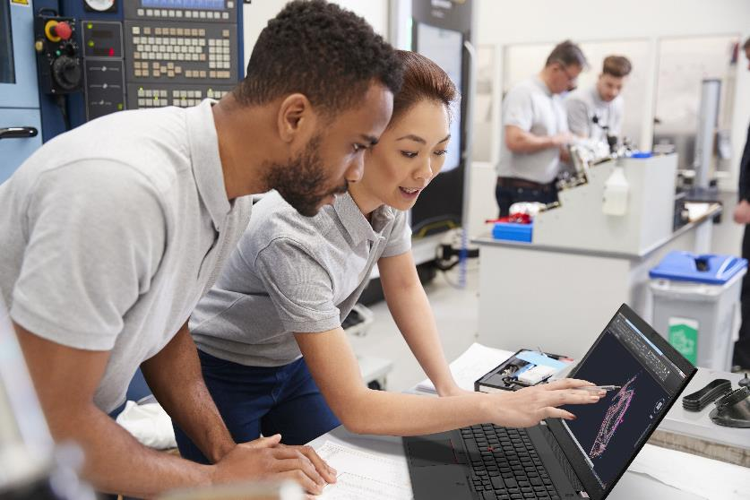
ThinkPad P15v Gen2 for Engineering Education
Remote Workstation-Ready!
A brilliant visual workspace and exceptional performance for technical educators and mechanical, structural, aerospace, civil, and industrial engineering students
11th Gen Intel® Core™ CPUs with AI-based intelligent performance
Now available with up to NVIDIA RTX™ A2000
Available stunning 15.6” IPS 4K UHD display with color calibration
Ultra-Performance mode to accelerate technical education outcomes
High-capacity battery with Rapid Charge technology
“Increased flexibility within the 15-inch space…for professional workflows.”
- Hexus
 | Mainstream | Recommended
Part Number | 21A90036US | 21A90039US
List Price | $2,019 | $2,459
Processor | Intel® Core™ i7-11800H (8C) | Intel® Core™ i7-11800H (8C)
Graphics | NVIDIA® T600 4GB GDDR6 | NVIDIA® T1200 4GB GDDR6
Memory | 16GB (1x16GB) DDR4 3200MHz | 32GB (1x32GB) DDR4 3200MHz
Storage | 512GB M.2 PCIe NVMe | 512GB M.2 PCIe NVMe
Display | 15.6" FHD (1920x1080) IPS 300nits Anti-glare, 45% NTSC Color, IR camera | Touch 15.6" FHD (1920x1080) IPS 300nitt, 45% NTSC Color, IR camera
Warranty | 3 Year Premier Support | 3 Year Premier Support
ISV-certified with the most popular professional applications to accelerate optimal learning outcomes:
3 Year Accidental Damage Protection
5PS0V07049 | $129 MSRP
ThinkVision
P24q
61F5GAR1US | $304 MSRP
Thunderbolt 4 Workstation Dock
40B00300US | $419 MSRP

Slide 22
ThinkPad P1 Gen4 for Engineering Education
Remote Workstation-Ready!
On-the-go performance in a premium package for technical educators and mechanical, structural, aerospace, civil, and industrial engineering students
“A lean mean workstation with great performance without the bulk.”
- Storage Review
Leveled-up 3D graphics performance now up to NVIDIA RTX™ A5000
Premium user experience with Dolby Atmos® sound and Dolby Vision™
Durable MIL-STD testing and market-leading reliability
Ultra-Performance mode to accelerate technical education outcomes
Larger 90WH battery with Rapid Charge technology for max uptime
 | Mainstream | Recommended
Part Number | 20Y3003MUS* | 20Y30033US*
List Price | $2,319 | $2,979
Processor | Intel® Core™ i7-11800H (8c) | Intel® Core™ i7-11800H (8C)
Graphics | NVIDIA® T1200 4GB GDDR6 | NVIDIA RTX™ A2000 4GB GDDR6
Memory | 16GB (1x16GB) DDR4 3200MHz | 32GB (1x32GB) DDR4 3200MHz
Storage | 512GB M.2 PCIe NVMe | 1TB M.2 PCIe NVMe
Display | 16" WQXGA (2560x1600) “QHD+” IPS 400nit, 100% sRGB Color, IR Camera | Touch 16.0" WQUXGA (3840x2400) “UHD+” IPS 600nit, Factory-Color-Calibrated 100% Adobe Color, Dolby Vision HDR, IR Camera
Warranty | 3 Year Premier Support | 3 Year Premier Support
ISV-certified with the most popular professional applications to accelerate optimal learning outcomes:
3 Year Accidental Damage Protection
5PS0V07049 | $129 MSRP
ThinkVision
P24q
61F5GAR1US | $304 MSRP
Thunderbolt 4 Workstation Dock
40B00300US | $419 MSRP

Slide 23
ThinkPad P15 Gen2 for Engineering Education
Remote Workstation-Ready!
On-the-go, high performance workstation computing for technical educators and mechanical, structural, aerospace, civil, and industrial engineering students
“…obliterates big workflows like nobody's business.”
-PC Mag
11th Gen Intel® Core™ CPUs with AI-based intelligent performance
Available XR-ready NVIDIA RTX™ A5000 to transcend design review
Durable MIL-STD testing and market-leading reliability
Ultra-Performance mode to throttle your workflow to the redline
Ultra-Performance mode to accelerate technical education outcomes
 | Mainstream | Recommended
Part Number | 20YQ0031US* | 20YQ003WUS*
List Price | $2,199 | $2,589
Processor | Intel® Core™ i7-11800H (8c) | Intel® Core™ i7-11800H (8c)
Graphics | NVIDIA® T1200 4GB GDDR6 | NVIDIA RTX™ A2000 4GB GDDR
Memory | 16GB (1x16GB) DDR4 3200MHz | 32GB (2x16GB) DDR4 3200MHz
Storage | 512GB M.2 PCIe NVMe | 1TB M.2 PCIe NVMe
Display | 15.6" FHD (1920x1080) IPS 500nit, 100% sRGB Color, Dolby Vision, IR Camera | 15.6" FHD (1920x1080) IPS 500nit, 100% sRGB Color, Dolby Vision, IR Camera
Warranty | 3 Year Premier Support | 3 Year Premier Support
ISV-certified with the most popular professional applications to accelerate optimal learning outcomes:
3 Year Accidental Damage Protection
5PS0V07049 | $129 MSRP
ThinkVision
P24q
61F5GAR1US | $304 MSRP
Thunderbolt 4 Workstation Dock
40B00300US | $419 MSRP

Slide 24
ThinkStation P620 for Engineering Education
Remote Workstation-Ready!
Unprecedented levels of power, performance and flexibility in a single socket CPU platform for mechanical, structural, aerospace, civil, and industrial engineering students
Tool-less, modular design with FLEX features for versatile IO options
AMD Ryzen™ Threadripper™ PRO CPUs with up to 64 cores
Base clock 14% higher than similar core density competitor CPUs
Available Ampere-based NVIDIA® RTX™ graphics with 2nd gen RT Cores
Up to 1TB octa-channel memory
“The ThinkStation P620 throws in everything you could ever need, and then some.”
- Windows Central
 | Mainstream | Recommended
Part Number | 30E000DSUS* | 30E000DPUS*
List Price | $2,769 | $3,979
Processor | AMD Ryzen™ Threadripper™ PRO 3945WX 12c 4.0GHz | AMD Ryzen™ Threadripper™ PRO 3945WX 12c 4.0GHz
Graphics | NVIDIA® T600 4GB | NVIDIA RTX™ A4000 16GB
Memory | 32GB (2x16GB) DDR4 3200MHz ECC RDIMM | 32GB (2x16GB) DDR4 3200MHz ECC RDIMM
Storage | 1TB M.2 PCIe Gen4 NVMe | 1TB M.2 PCIe Gen4 NVMe
Power Supply | 1000W | 1000W
Warranty | 3 Year Premier Support | 3 Year Premier Support
ISV-certified with the most popular professional applications to accelerate business results or learning outcomes:
16GB 3200MHz ECC RAM
4X70Z90847 | $200 MSRP
ThinkVision
P27q
61EAGAR6US | $404 MSRP
NVIDIA® RTX™ A5000 16GB
4X61D97085 | $2,999 MSRP

Slide 25
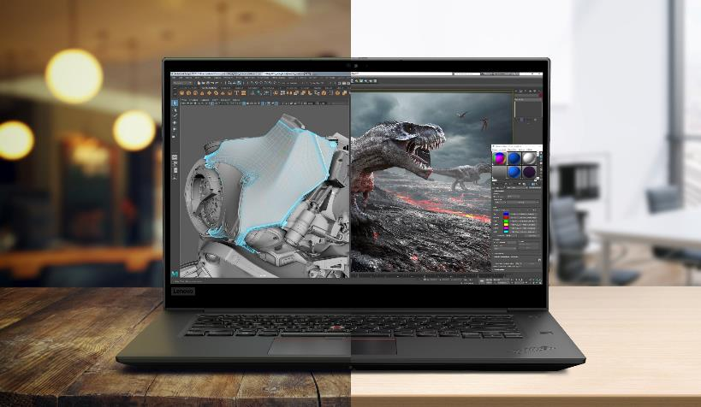
ThinkPad P1 Gen4 for Creative Arts Education
Remote Workstation-Ready!
On-the-go performance in a premium package for media & digital arts educators and students
11th Gen Intel® Core™ CPUs with AI-based intelligent performance
Leveled-up 3D graphics performance now up to NVIDIA RTX™ A5000
Premium user experience with Dolby Atmos® sound and Dolby Vision™
Durable MIL-STD testing and market-leading reliability
Stunning UHD+ HDR option with Wacom® support for intuitive drafting
“The best combination of performance, weight, screen quality, and battery life.”
-Wirecutter
 | Mainstream | Recommended
Part Number | 20Y3003MUS* | 20Y3003TUS*
List Price | $2,319 | $4,199
Processor | Intel® Core™ i7-11800H (8c) | Intel® Core™ i9-11950H vPro (8c)
Graphics | NVIDIA® T1200 4GB GDDR6 | NVIDIA GeForce RTX™ 3080 16GB GDDR6
Memory | 16GB (1x16GB) DDR4 3200MHz | 32GB (1x32GB) DDR4 3200MHz
Storage | 512GB M.2 PCIe NVMe | 1TB M.2 PCIe NVMe
Display | 16" WQXGA (2560x1600) “QHD+” IPS 400nit, 100% sRGB Color, IR Camera | Touch 16.0" WQUXGA (3840x2400) “UHD+” IPS 600nit, Factory-Color-Calibrated, 100% Adobe Color, Dolby Vision HDR, IR Camera
Warranty | 3 Year Premier Support | 3 Year Premier Support
ISV-certified with the most popular professional applications to accelerate optimal learning outcomes:
3 Year Accidental Damage Protection
5PS0V07049 | $129 MSRP
ThinkVision
P24q
61F5GAR1US | $304 MSRP
Thunderbolt 4 Workstation Dock
40B00300US | $419 MSRP
*GeForce-based systems NOT ISV-certified

Slide 26
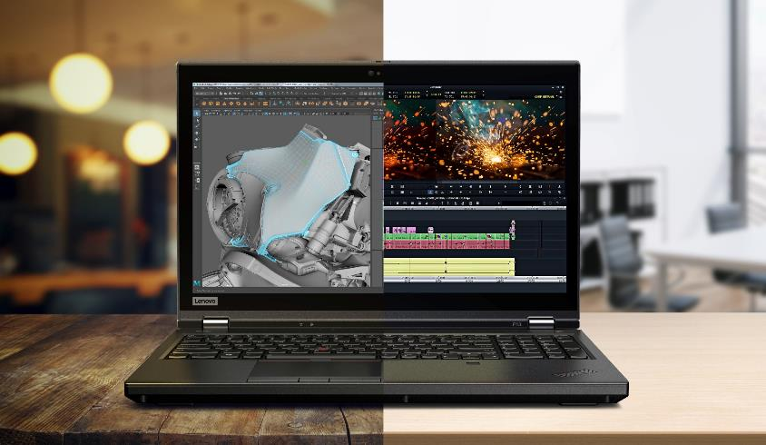
ThinkPad P15 Gen2 for Creative Arts Education
Remote Workstation-Ready!
On-the-go high performance visual computing and rapid rendering for media & digital arts educators and students
11th Gen Intel® Core™ CPUs with AI-based intelligent performance
Available XR-ready NVIDIA RTX™ A5000 to transcend design review
Durable MIL-STD testing and market-leading reliability
Ultra-Performance mode to accelerate technical education outcomes
Free-of-charge Lenovo Performance Tuner to optimize workflow
“…obliterates big workflows like nobody's business.”
-PCMag
 | Mainstream | Recommended
Part Number | 20YQ003WUS | 20YQ0030US*
List Price | $2,589 | $3,229
Processor | Intel® Core™ i7-11800H (8c) | Intel® Core™ i7-11850H vPro (8c)
Graphics | NVIDIA RTX™ A2000 4GB GDDR6 | NVIDIA RTX™ A3000 6GB GDDR6
Memory | 16GB (1x16GB) DDR4 3200MHz | 32GB (2x16GB) DDR4 3200MHz
Storage | 512GB M.2 PCIe NVMe | 1TB M.2 PCIe NVMe
Display | 15.6" FHD (1920x1080) IPS 500nits Anti-glare, 100% sRGB Color, Dolby Vision, IR Camera | 15.6" FHD (1920x1080) IPS 500nits Anti-glare, 100% sRGB Color, Dolby Vision, IR Camera
Warranty | 3 Year Premier Support | 3 Year Premier Support
ISV-certified with the most popular professional applications to accelerate optimal learning outcomes:
3 Year Accidental Damage Protection
5PS0V07049 | $129 MSRP
ThinkVision
P24q
61F5GAR1US | $304 MSRP
Thunderbolt 4 Workstation Dock
40B00300US | $419 MSRP

Slide 27
ThinkStation P620 for Creative Arts Education
Remote Workstation-Ready!
Unprecedented levels of power, performance and flexibility in a single socket CPU platform for media & digital arts educators and students
Tool-less, modular design with FLEX features for versatile IO options
AMD Ryzen™ Threadripper™ PRO CPUs with up to 64 cores
Multi-threaded performance up to 39% higher than dual CPU competitors
Latest Ampere-based NVIDIA® RTX™ graphics with 2nd gen RT Cores
Up to 1TB octa-channel memory
 | Mainstream | Recommended
Part Number | 30E000DPUS* | 30E000ARUS*
List Price | $3,979 | $5,939
Processor | AMD Ryzen™ Threadripper™ PRO 3945WX 12c 4.0GHz | AMD Ryzen™ Threadripper™ PRO 3955WX 16c 3.9GHz
Graphics | NVIDIA RTX™ A4000 16GB GDDR6 | NVIDIA Quadro® RTX™ A5000 16GB
Memory | 32GB DDR4 (2x32GB) 3200MHz RDIMM ECC | 64GB (4x16GB) DDR4 3200MHz ECC RDIMM
Storage | 1TB M.2 PCIe Gen4 NVMe | 1TB M.2 PCIe Gen4 NVMe
Power Supply | 1000W | 1000W
Warranty | 3 Year Premier Support | 3 Year Premier Support
“The ThinkStation P620 throws in everything you could ever need, and then some.”
- Windows Central
ISV-certified with the most popular professional applications to accelerate business results and learning outcomes:
16GB 3200MHz ECC RAM
4X70Z90847 | $200 MSRP
ThinkVision
P27q
61EAGAR6US | $404 MSRP
NVIDIA® RTX™ A6000 48GB
4X61D17227 | $5,999 MSRP

Slide 28
ThinkPad P15v Gen2 for Computer Science Education
Remote Workstation-Ready!
A wallet-friendly, computationally powerful workstation for computer science & software engineering educators & students
“Increased flexibility within the 15-inch space…for professional workflows.”
- Hexus
11th Gen Intel® Core™ CPUs with AI-based intelligent performance
Now available with up to NVIDIA RTX™ A2000
Available stunning 15.6” IPS 4K UHD display with color calibration
Ultra-Performance mode to accelerate technical education outcomes
High-capacity battery with Rapid Charge technology
 | Mainstream | Recommended
Part Number | 21A90036US* | 21A9002XUS*
List Price | $2,019 | $2,799
Processor | Intel® Core™ i7-11850H vPro (8c) | Intel® Core™ i9-11950H (8c)
Graphics | NVIDIA® T600 4GB GDDR6 | NVIDIA RTX™ A2000 4GB GDDR6
Memory | 16GB (1x16GB) DDR4 3200MHz | 32GB (1x32GB) DDR4 3200MHz
Storage | 512GB M.2 PCIe NVMe | 1TB M.2 PCIe NVMe
Display | 15.6" FHD (1920x1080) IPS 300nit, 45% NTSC Color, IR Camera | 15.6" FHD (1920x1080) IPS 300nit, 45% NTSC Color, IR Camera
Warranty | 3 Year Premier Support | 3 Year Premier Support
3 Year Accidental Damage Protection
5PS0V07049 | $129 MSRP
ThinkVision
P24q
61F5GAR1US | $304 MSRP
Thunderbolt 4 Workstation Dock
40B00300US | $419 MSRP

Slide 29
ThinkPad P1 Gen4 for Computer Science Education
Remote Workstation-Ready!
On-the-go performance in a premium package for computer science & software engineering educators & students
11th Gen Intel® Core™ CPUs with AI-based intelligent performance
Leveled-up 3D graphics performance now up to NVIDIA RTX™ A5000
Durable MIL-STD testing and market-leading reliability
Ultra-Performance mode to accelerate technical education outcomes
Diverse and holistic Linux support
 | Mainstream | Recommended
Part Number | 20Y3005WUS | 20Y30033US*
List Price | $2,369 | $2,979
Processor | Intel® Core™ i7-11850H vPro (8c) | Intel® Core™ i7-11800H (8c)
Graphics | Integrated Intel® UHD Graphics | NVIDIA RTX™ A2000 4GB GDDR6
Memory | 16GB (1x16GB) DDR4 3200MHz | 32GB (1x32GB) DDR4 3200MHz
Storage | 512GB M.2 PCIe NVMe | 1TB M.2 PCIe NVMe
Display | 16" WQXGA (2560x1600) “QHD+” IPS 400nit Anti-glare, 100% sRGB Color, IR Camera | Touch 16.0" WQUXGA (3840x2400) “UHD+” IPS 600nit, Factory-Color-Calibrated, 100% Adobe Color, Dolby Vision HDR, IR Camera
Warranty | 3 Year Premier Support | 3 Year Premier Support
“Best laptop for programming in 2020.”
-Creative Bloq
3 Year Accidental Damage Protection
5PS0V07049 | $129 MSRP
ThinkVision
P24q
61F5GAR1US | $304 MSRP
Thunderbolt 4 Workstation Dock
40B00300US | $419 MSRP

Slide 30
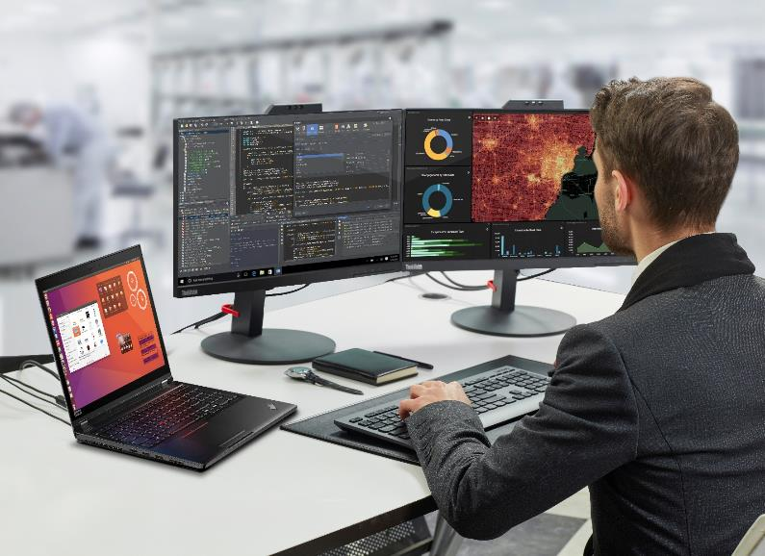
ThinkPad P15 Gen2 for Computer Science Education
Remote Workstation-Ready!
On-the-go high performance programming, scripting, and compiling power for computer science & software engineering educators & students
“…obliterates big workflows like nobody's business.”
-PC Mag
Most powerful 15” developer mobile workstation available
Easily-scalable storage configurations with redundancy options
Durable MIL-STD testing and market-leading reliability
Up to 128GB total system memory and 4TB PCIe NVMe storage
Diverse and holistic Linux support
 | Mainstream | Recommended
Part Number | 20YQ0042US* | 20YQ003NUS*
List Price | $2,459 | $3,849
Processor | Intel® Core™ i7-11850H vPro (8c) | Intel® Core™ i9-11950H vPro (8c)
Graphics | NVIDIA® T1200 4GB GDDR6 | NVIDIA RTX™ A4000 8GB GDDR6
Memory | 16GB (1x16GB) DDR4 3200MHz | 32GB (2x16GB) DDR4 3200MHz
Storage | 512GB M.2 PCIe NVMe | 1TB M.2 PCIe NVMe
Display | 15.6" FHD (1920x1080) IPS 500nit, 100% sRGB Color, Dolby Vision HDR, IR Camera | 15.6" FHD (1920x1080) IPS 500nit, 100% sRGB Color, Dolby Vision HDR, IR Camera
Warranty | 3 Year Premier Support | 3 Year Premier Support
3 Year Accidental Damage Protection
5PS0V07049 | $129 MSRP
ThinkVision
P24q
61F5GAR1US | $304 MSRP
Thunderbolt 4 Workstation Dock
40B00300US | $419 MSRP

Slide 31
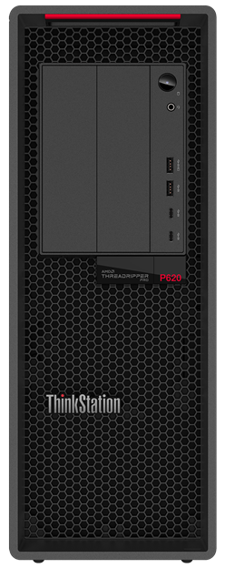
ThinkStation P620 for Computer Science Education
Remote Workstation-Ready!
High performance programming, scripting, and compiling power in an elegant package for computer science & software engineering educators & students
“The ThinkStation P620 throws in everything you could ever need, and then some.”
- Windows Central
Tool-less, modular design with FLEX features for versatile IO options
AMD Ryzen™ Threadripper™ PRO CPUs with up to 64 cores
Multi-threaded performance up to 39% higher than dual CPU platforms
Latest NVIDIA RTX™ GPUs with 3rd gen Tensor Cores
Up to 1TB octa channel system memory
 | Mainstream | Recommended
Part Number | 30E000DSUS* | 30E000ARUS*
List Price | $2,769 | $5,939
Processor | AMD Ryzen™ Threadripper™ PRO 3945WX 12c 4.0GHz | AMD Ryzen™ Threadripper™ PRO 3955WX 16c, 3.9GHz
Graphics | NVIDIA® T600 4GB | NVIDIA® RTX™ A5000 24GB GDDR6
Memory | 32GB (2x16GB) DDR4 3200MHz ECC RDIMM | 64GB (4x16GB) DDR4 3200MHz ECC RDIMM
Storage | 1TB M.2 PCIe Gen4 NVMe | 1TB M.2 PCIe Gen4 NVMe
Power Supply | 1000W | 1000W
Warranty | 3 Year Premier Support | 3 Year Premier Support
16GB 3200MHz ECC RAM
4X70Z90847 | $200 MSRP
ThinkVision
P27q
61EAGAR6US | $404 MSRP
2TB M.2 PCIe Gen4 NVMe SSD
4XB1D04758 | $699 MSRP

Slide 32
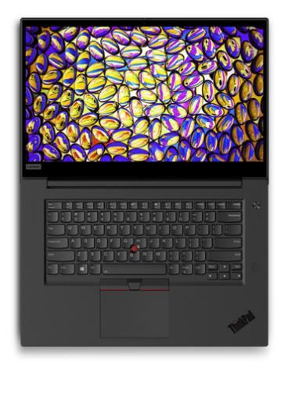
Power User (Workstation) Device – Decision Tree
This is not intended to represent all of our products. It represents the products you’ll sell most frequently.
$2,149+
Customer Wants
17” Larger Screen/ Ultimate Performance
ThinkPad P17 Gen2
Core H and Xeon Processors
Up to NVIDIA RTX A5000 / 16GB
17” panel, starting at 8.09lbs and 24.31 to 32.45mm
8.3hrs battery life (MM18)
Four DIMM Sockets (# in use varies on config)
Customer Wants
Ultimate Performance
ThinkPad P15 Gen2
$1,939+
Customer Wants
Prosumer At Max Performance
ThinkPad T15g Gen2
$2,319+
Core H and Xeon Processors
Up to NVIDIA RTX A5000 / 16GB
15.6” panel, starting at 6.32lbs and 24.5-31.45mm
9hrs battery life (MM18)
Four DIMM Sockets (# in use varies on config)
Core H and Xeon Processors
NVIDIA GeForce RTX 3080 / 8GB
15.6” panel, starting at 4.57lbs and 24.2mm
7hrs battery life (MM18)
Four DIMM Sockets (# in use varies on config)
ThinkPad P1
Start with:
ThinkPad P1 Gen4
$2,199+
$1,759+
Customer Wants
Performance CPU / Entry Pro GPU
ThinkPad P15v Gen2
Core H and Xeon Processors
Up to NVIDIA A5000 / GeForce RTX3080
16” panel, starting at 3.99lbs and 17.7mm
10.9hrs battery life (MM18)
Two DIMM Sockets (# in use varies on config)
Customer Wants
Lower Price / Entry CPU & dGPU
ThinkPad P15s Gen2
$1,549+
Core H Processors
Up to NVIDIA A2000 / 4GB (P15v)
15.6” panel, starting at 4.57lbs and 24.2mm
7.5hrs battery life (MM18)
Two DIMM Sockets (# in use varies on config)
Core U Processors and NVIDIA T500 4GB
15.6” panel, starting at 3.86lbs and 19.1mm
9.3hrs battery life (MM18)
One soldered + One DIMM Socket
Customer Wants
Performance CPU w/ Entry GeForce
T15p Gen2
$1,659+
Customer Wants Max Portability in
14” Display with an AMD Option
ThinkPad P14s Gen2
$1,199+ (AMD)
$1,539+ (Intel)
Core H Processors
Up to NVIDIA GeForce 1050 3GB
15.6” panel, starting at 4.57lbs and 24.2mm
10hrs battery life (MM18)
Two DIMM Sockets (# in use varies on config)
Core U Processors or AMD Ryzen Pro APUs
NVIDIA T500/4GB + Intel Iris XE or AMD Pro Driver Support
14” panel, starting at 3.24lbs and 17.9mm
14.5hrs (Intel) or 12.5hrs (AMD) battery life (MM18)
One soldered + One DIMM Socket
​
2021 Lenovo confidential. All rights reserved.

Slide 33
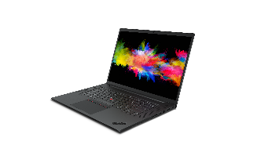
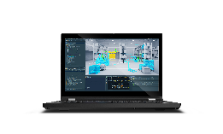
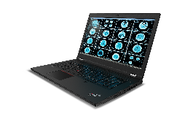
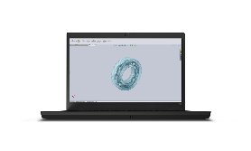
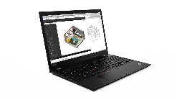
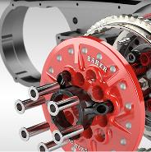
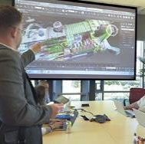
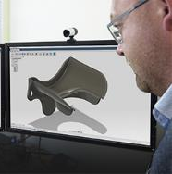
Generational Leaps in Graphics Performance
2021 ThinkPad P Series powering the future of high-performance visual computing from anywhere…
P15 Gen2
P17 Gen2
P1 Gen4
P15s Gen2
P14s Gen2
P15v Gen2
Courtesy of Dassault Systèmes SOLIDWORKS.
+ Higher Performance
+ Large GPU Memory
+ Adv. Multi-App Workflows
+ Data Science
+ Higher Performance
+ Larger GPU Memory
+ Adv. Multi-App Workflows
+ Data Science
+ Higher Performance
+ Large GPU Memory
+ Adv. Multi-App Workflows
+ Data Science
+ Higher Performance
+ New RTX Ray tracing and AI
4 GB GDDR6 Memory
Fast 2D/3D Graphics
ISV Certifications
Pro App Tuning
4 GB GDDR6 Memory
T1200 4GB
RTX A2000 4GB
RTX A3000 6GB
RTX A4000 8GB
RTX A5000 16GB
T1200 4GB
RTX A2000 4GB
RTX A3000 6GB
RTX A4000 8GB
RTX A5000 16GB
T1200 4GB
RTX A2000 4GB
RTX A3000 6GB
RTX A4000 8GB
RTX A5000 16GB
T600 4GB
T1200 4GB
RTX A2000 4GB
T500 4GB
Up to 5X faster
vs integrated graphics¹
A2000 Up to 11X faster vs P2000²
A2000 3X faster vs T2000²
Up to 7X faster vs P3200²
80% faster vs RTX 3000²
Up to 8X faster vs P4200²
80% faster vs RTX 4000²
Up to 7X faster vs P5200²
60% faster vs RTX 5000²
1 SPECviewperf 2020 tests run on T500 vs i7-1185G7 CPU with integrated graphics. Performance may vary by scene or system.
2 Tests run on Intel Core i7-10750H. 16GB system memory. Win 10 E x64. NVIDIA driver 461.75 MSHybrid. Rendering – Keyshot viewer scores. Performance may vary by system or scene.
Notes:
NVIDIA RTX laptop GPUs offer incredible performance across the lineup. The NVIDIA T500, T600, and T1200 GPUs offer great performance improvements vs integrated graphics – up to 5X faster than iGP on the NVIDIA T500.
With the new NVIDIA RTX A2000 GPU, we’re introducing ray tracing and AI capabilities to the 2000-class level for the first time, bringing the power of RTX to more professionals. The A2000 is a significant step up from the previous generation T2000 GPU not only due to RTX capability but also due to incredible performance gains – up to 3X faster rendering than the previous generation.
The RTX A3000, A4000, and A5000 deliver even more performance – ranging from up to 60% to 80% faster compared to their previous generation counterparts in terms of rendering performance.
With the RTX A5000 laptop GPU leading in performance in the new lineup, it also includes up to 16GB of GPU memory to handle advanced multi-app workflows, and tackle complex models and AI datasts.

