Slide 1
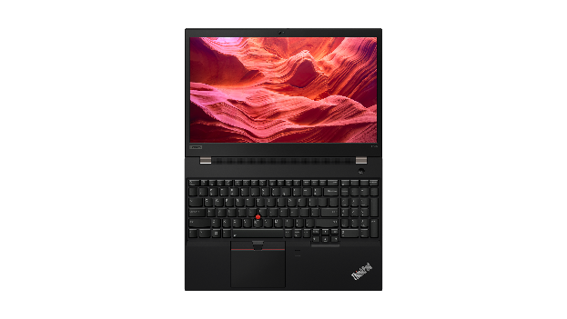
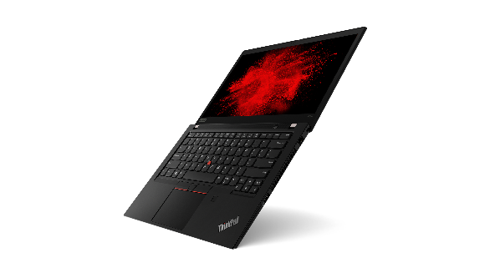
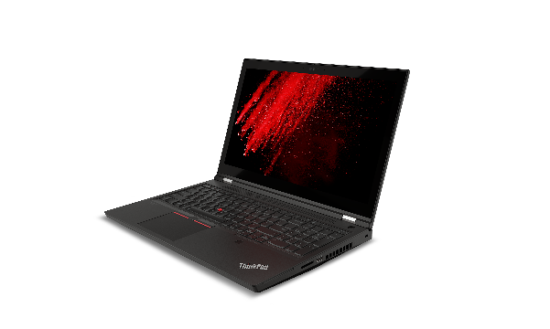
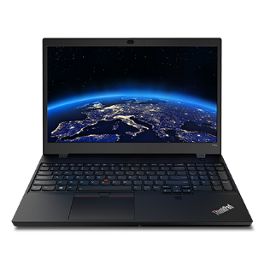
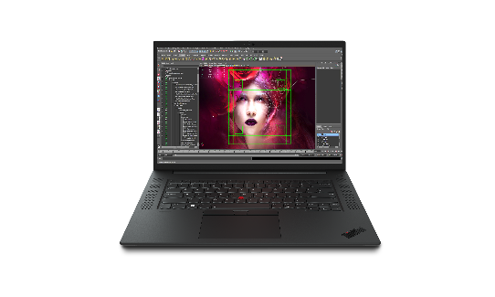
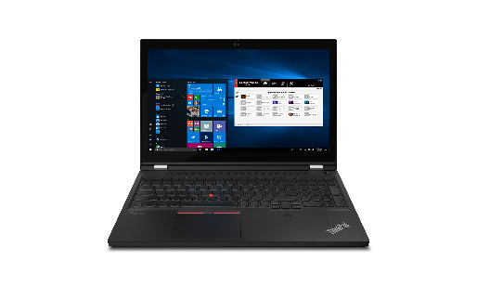
LENOVO TOPSELLER
ThinkPad Mobile Workstations
[ 1 OF 6 ]
ThinkPad P14s Intel
ThinkPad P14s AMD
Ultra-portable 14-inch
with all-day battery
ThinkPad P15s
Thin & light 15.6-inch with all-day battery
ThinkPad P15v
ThinkPad T15p
Value 15.6-inch
NVIDIA Professional (P15v) or Consumer GeForce Graphics (T15p)
ThinkPad P1
Ultra-premium 16-inch*
Now even more performance up to NVIDIA RTX A5000 Graphics
ThinkPad P15
ThinkPad T15g
Performance 15.6-inch
NVIDIA RTX Professional (P15) or Consumer GeForce Graphics (T15g)
ThinkPad P17
Ultimate power and only
17-inch ThinkPad
*16” panel available on ThinkPad P1 Gen4 only

Slide 2
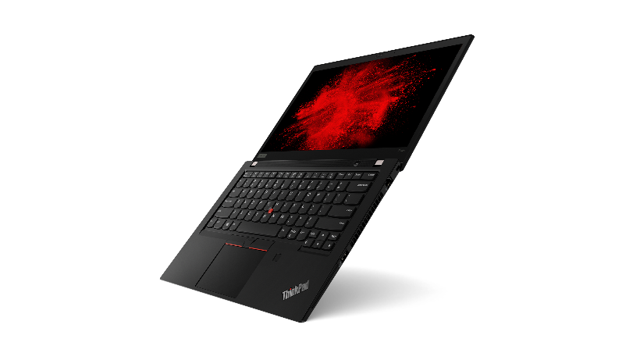
LENOVO TOPSELLER
ThinkPad Mobile Workstations
[ 2 OF 6 ]
P14s Gen2 14” Ultra-portable | $1,769 | $1,859 | $1,979 | $2,029 | $2,129 | $2,459 | $2,599 | $2,799
 | 20VX008YUS | 20VX009HUS | 20VX0098US | 20VX008XUS | 20VX009JUS | 20VX0092US | 20VX008UUS | 20VX0097US
 | Core i7-1165G7 | Core i5-1145G7 | Core i7-1165G7 | Core i7-1165G7 | Core i7-1185G7 | Core i7-1165G7 | Core i7-1185G7 | Core i7-1185G7
 | 8GB DDR4 3200 | 16GB DDR4 3200 | 16GB DDR4 3200 | 16GB DDR4 3200 | 16GB DDR4 3200 | 32GB DDR4 3200 | 32GB DDR4 3200 | 32GB DDR4 3200
 | 256GB PCIe SSD | 256GB PCIe SSD | 512GB PCIe SSD | 512GB PCIe SSD | 512GB PCIe SSD | 1 TB PCIe SSD | 1 TB PCIe SSD | 1 TB PCIe SSD
 | 14” FHD IPS | 14” FHD IPS | 14” FHD IPS | 14” FHD IPS Touch | 14” FHD IPS | 14” FHD IPS | 14” FHD IPS | 14” UHD IPS
 | NVIDIA Quadro T500 4GB | NVIDIA Quadro T500 4GB | NVIDIA Quadro T500 4GB | NVIDIA Quadro T500 4GB | NVIDIA Quadro T500 4GB | NVIDIA Quadro T500 4GB | NVIDIA Quadro T500 4GB | NVIDIA Quadro T500 4GB
 | Win 10 Pro 64 | Win 10 Pro 64 | Win 10 Pro 64 | Win 10 Pro 64 | Win 10 Pro 64 | Win 10 Pro 64 | Win 10 Pro 64 | Win 10 Pro 64
 | Premier Support | Premier Support | Premier Support | Premier Support | Premier Support | Premier Support | Premier Support | Premier Support
 | 3 Year Warranty | 3 Year Warranty | 3 Year Warranty | 3 Year Warranty | 3 Year Warranty | 3 Year Warranty | 3 Year Warranty | 3 Year Warranty
NEW!
P14s Gen2
P14s Gen1 14” Ultra-portable | $1,599 | $1,669 | $1,799 | $1,819 | $1,869 | $1,969 | $2,019 | $2,359 | $2,499 | $2,689
 | Rebate $25 | Rebate $25 | Rebate $25 | Rebate $20 | Rebate $15 | Rebate $60 | Rebate $55 | Rebate $80 | Rebate $100 | Rebate $150
 | 20S4001NUS | 20S4002LUS | 20S40024US | 20S40023US | 20S4003FUS | 20S40021US | 20S4003EUS | 20S4003PUS | 20S4003SUS | 20S4003UUS
 | Core i7-10510U 4C | Core i5-10310U 4C | Core i5-10310U 4C | Core i7-10510U 4C | Core i7-10510U 4C | Core i7-10610U 4C | Core i7-10610U 4C | Core i7-10510U 4C | Core i7-10610U 4C | Core i7-10610U 4C
 | 8GB DDR4 3200 | 8GB DDR4 3200 | 16GB DDR4 3200 | 16GB DDR4 3200 | 16GB DDR4 3200 | 16GB DDR4 3200 | 16GB DDR4 3200 | 32GB DDR4 3200 | 32GB DDR4 3200 | 32GB DDR4 3200
 | 256GB PCIe SSD | 256GB PCIe SSD | 512GB PCIe SSD | 512GB PCIe SSD | 512GB PCIe SSD | 512GB PCIe SSD | 512GB PCIe SSD | 1 TB PCIe SSD | 1 TB PCIe SSD | 1 TB PCIe SSD
 | 14” FHD IPS | 14” FHD IPS 400nit Low Power | 14” FHD IPS | 14” FHD IPS | 14” FHD IPS Touch | 14” FHD IPS | 14” FHD IPS Touch | 14” FHD IPS | 14” FHD IPS | 14” 4K UHD
 | NVIDIA Quadro P520 | NVIDIA Quadro P520 | NVIDIA Quadro P520 | NVIDIA Quadro P520 | NVIDIA Quadro P520 | NVIDIA Quadro P520 | NVIDIA Quadro P520 | NVIDIA Quadro P520 | NVIDIA Quadro P520 | NVIDIA Quadro P520
 | Win 10 Pro 64 | Win 10 Pro 64 | Win 10 Pro 64 | Win 10 Pro 64 | Win 10 Pro 64 | Win 10 Pro 64 | Win 10 Pro 64 | Win 10 Pro 64 | Win 10 Pro 64 | Win 10 Pro 64
 |  |  |  |  |  |  |  | Premier Support | Premier Support | Premier Support
 | 3 Year Warranty | 3 Year Warranty | 3 Year Warranty | 3 Year Warranty | 3 Year Warranty | 3 Year Warranty | 3 Year Warranty | 3 Year Warranty | 3 Year Warranty | 3 Year Warranty
While supplies last on these models

Slide 3
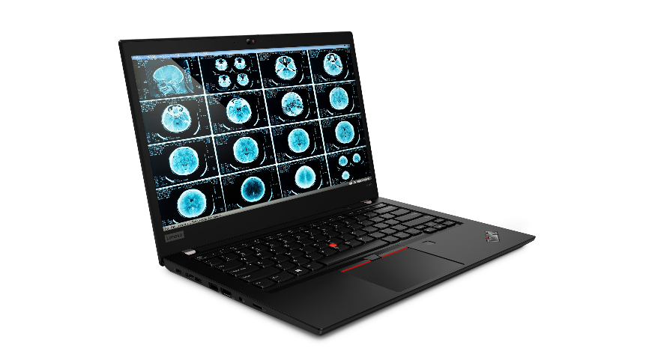
P14s Gen2 AMD 14” Entry Ultra-portable | $1,659 | $1,799 | $1,899 | $2,039 | $2,139
 | 21A0003PUS | 21A0003SUS | 21A0003QUS | 21A0003TUS | 21A0003XUS
 | AMD Ryzen 7 PRO 5850U 8C | AMD Ryzen 5 PRO 5650U 6C | AMD Ryzen 7 PRO 5850U 8C | AMD Ryzen 5 PRO 5650U 6C | AMD Ryzen 7 PRO 5850U 8C
 | 16GB DDR4 3200 | 32GB DDR4 3200 | 32GB DDR4 3200 | 32GB DDR4 3200 | 32GB DDR4 3200
 | 512GB PCIe SSD | 512GB PCIe SSD | 512GB PCIe SSD | 1TB PCIe SSD | 1TB PCIe SSD
 | 14” FHD 300n | 14” FHD 300n Touch | 14” FHD 300n Touch | 14” FHD 300n | 14” FHD 400n
 | AMD Radeon Graphics | AMD Radeon Graphics | AMD Radeon Graphics | AMD Radeon Graphics | AMD Radeon Graphics
 | Win 10 Pro 64 | Win 10 Pro 64 | Win 10 Pro 64 | Win 10 Pro 64 | Win 10 Pro 64
 | Premier Support | Premier Support | Premier Support | Premier Support | Premier Support
 | 3 Year Warranty | 3 Year Warranty | 3 Year Warranty | 3 Year Warranty | 3 Year Warranty
NEW!
P14s AMD Gen2
P14s Gen1 AMD 14” Entry Ultra-portable | $1,549 | $1,599 | $1,619 | $1,749 | $1,769
 | 20Y10011US | 20Y10015US | 20Y10017US | 20Y10019US | 20Y10018US
 | AMD Ryzen 7 PRO 4750U | AMD Ryzen 7 PRO 4750U | AMD Ryzen 7 PRO 4750U | AMD Ryzen 7 PRO 4750U | AMD Ryzen 7 PRO 4750U
 | 16GB DDR4 3200 | 16GB DDR4 3200 | 16GB DDR4 3200 | 32GB DDR4 3200 | 32GB DDR4 3200
 | 512GB PCIe SSD | 512GB PCIe SSD | 512GB PCIe SSD | 512GB PCIe SSD | 512GB PCIe SSD
 | 14” FHD 250n | 14” FHD 300n Touch | 14” FHD 400n | 14” FHD 300n Touch | 14” FHD 400n
 | AMD Radeon Graphics | AMD Radeon Graphics | AMD Radeon Graphics | AMD Radeon Graphics | AMD Radeon Graphics
 | Win 10 Pro 64 | Win 10 Pro 64 | Win 10 Pro 64 | Win 10 Pro 64 | Win 10 Pro 64
 | 3 Year Warranty | 3 Year Warranty | 3 Year Warranty | 3 Year Warranty | 3 Year Warranty

Slide 4
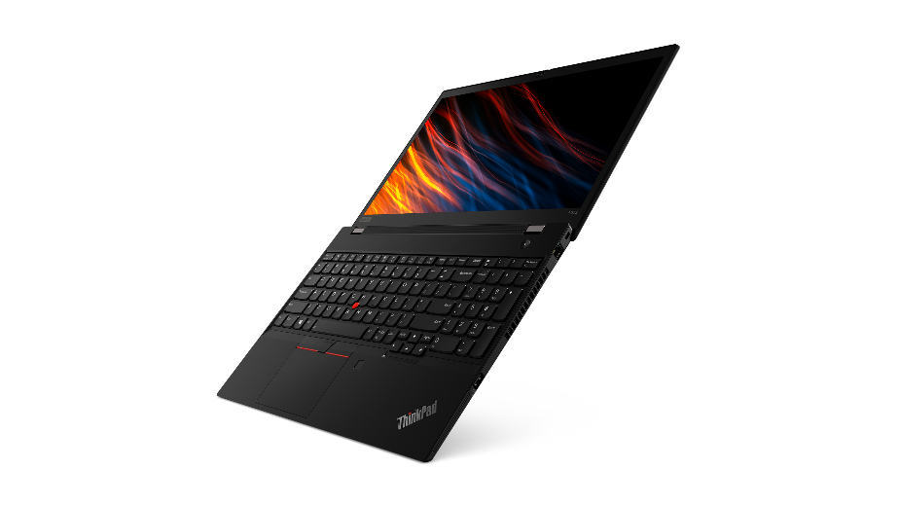
LENOVO TOPSELLER
ThinkPad Mobile Workstations
[ 3 OF 6 ]
P15s Gen2 15.6” Ultra-portable | $1,969 | $1,979 | $2,029 | $2,119 | $2,459 | $2,599 | $2,849
 | 20W6008DUS | 20W60089US | 20W60085US | 20W60087US | 20W6008AUS | 20W6008CUS | 20W60088US
 | Core i5-1145G7 | Core i7-1165G7 | Core i7-1165G7 | Core i7-1185G7 | Core i7-1165G7 | Core i7-1185G7 | Core i7-1185G7
 | 16GB DDR4 3200 | 16GB DDR4 3200 | 16GB DDR4 3200 | 16GB DDR4 3200 | 32GB DDR4 3200 | 32GB DDR4 3200 | 32GB DDR4 3200
 | 512GB PCIe SSD | 512GB PCIe SSD | 512GB PCIe SSD | 512GB PCIe SSD | 1 TB PCIe SSD | 1 TB PCIe SSD | 1 TB PCIe SSD
 | 15.6” FHD IPS | 15.6” FHD IPS | 15.6” FHD IPS Touch | 15.6” FHD IPS | 15.6” FHD IPS | 15.6” FHD IPS | 15.6” UHD IPS
 | NVIDIA Quadro T500 4GB | NVIDIA Quadro T500 4GB | NVIDIA Quadro T500 4GB | NVIDIA Quadro T500 4GB | NVIDIA Quadro T500 4GB | NVIDIA Quadro T500 4GB | NVIDIA Quadro T500 4GB
 | Win 10 Pro 64 | Win 10 Pro 64 | Win 10 Pro 64 | Win 10 Pro 64 | Win 10 Pro 64 | Win 10 Pro 64 | Win 10 Pro 64
 | Premier Support | Premier Support | Premier Support | Premier Support | Premier Support | Premier Support | Premier Support
 | 3 Year Warranty | 3 Year Warranty | 3 Year Warranty | 3 Year Warranty | 3 Year Warranty | 3 Year Warranty | 3 Year Warranty
NEW!
P15s Gen2
P15s Gen1 15.6” Ultra-portable | $1,579 | $1,789 | $1,799 | $1,859 | $1,939 | $1,989 | $2,349 | $2,499 | $2,759
 | Rebate $15 | Rebate $25 | Rebate $10 | Rebate $10 | Rebate $10 | Rebate $5 | Rebate $70 | Rebate $95 | Rebate $160
 | 20T4001JUS | 20T40025US | 20T4001VUS | 20T4002KUS | 20T4001SUS | 20T4002LUS | 20T40035US | 20T40034US | 20T4003QUS
 | Core i7-10510U 4C | Core i5-10310U 4C | Core i7-10510U 4C | Core i7-10510U 4C | Core i7-10610U 4C | Core i7-10610U 4C | Core i7-10510U 4C | Core i7-10610U 4C | Core i7-10610U 4C
 | 8GB DDR4 3200 | 16GB DDR4 3200 | 16GB DDR4 3200 | 16GB DDR4 3200 | 16GB DDR4 3200 | 16GB DDR4 3200 | 32GB DDR4 3200 | 32GB DDR4 3200 | 32GB DDR4 3200
 | 256GB PCIe SSD | 512GB PCIe SSD | 512GB PCIe SSD | 512GB PCIe SSD | 512GB PCIe SSD | 512GB PCIe SSD | 1 TB PCIe SSD | 1 TB PCIe SSD | 1 TB PCIe SSD
 | 15.6” FHD IPS | 15.6” FHD IPS | 15.6” FHD IPS | 15.6” FHD IPS Touch | 15.6” FHD IPS | 15.6” FHD IPS Touch | 15.6” FHD IPS | 15.6” FHD IPS | 15.6” 4K UHD
 | NVIDIA Quadro P520 | NVIDIA Quadro P520 | NVIDIA Quadro P520 | NVIDIA Quadro P520 | NVIDIA Quadro P520 | NVIDIA Quadro P520 | NVIDIA Quadro P520 | NVIDIA Quadro P520 | NVIDIA Quadro P520
 | Win 10 Pro 64 | Win 10 Pro 64 | Win 10 Pro 64 | Win 10 Pro 64 | Win 10 Pro 64 | Win 10 Pro 64 | Win 10 Pro 64 | Win 10 Pro 64 | Win 10 Pro 64
 |  |  |  |  |  |  | Premier Support | Premier Support | Premier Support
 | 3 Year Warranty | 3 Year Warranty | 3 Year Warranty | 3 Year Warranty | 3 Year Warranty | 3 Year Warranty | 3 Year Warranty | 3 Year Warranty | 3 Year Warranty
While supplies last on these models

Slide 5
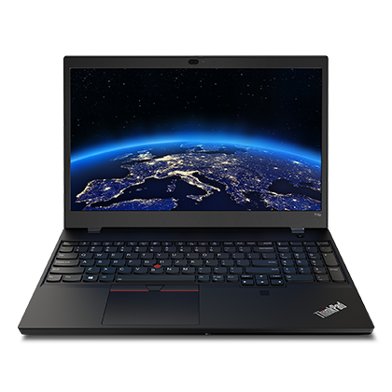
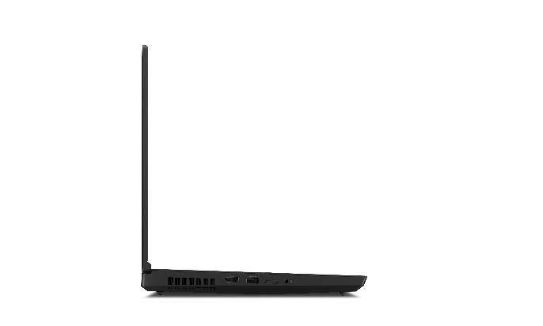
LENOVO TOPSELLER
ThinkPad Mobile Workstations
[ 4 OF 6 ]
T15p Gen2 Entry Power User/Prosumer | $1,659 | $2,019 | $2,259 | $2,419
 | 21A7001GUS | 21A7001MUS | 21A7001LUS | 21A7001TUS
 | Core i5-11400H 6C | Core i7-11800H 6C | Core i7-11800H 6C | Core i7- 11850H vPro 8C
 | 16GB DDR4 3200* | 16GB DDR4 3200 | 16GB DDR4 3200 | 16GB DDR4 3200
 | 256GB PCIe SSD | 512GB PCIe SSD | 1TB PCIe SSD | 512GB PCIe SSD
 | 15.6" FHD | 15.6" FHD IR Cam | 15.6" FHD IR Cam | 15.6" UHD HDR IR Cam
 | UMA Graphics | NVIDIA GeForce GTX 1650 | NVIDIA GeForce GTX 1650 | NVIDIA GeForce GTX 1650
 | Premier Support | Premier Support | Premier Support | Premier Support
 | 3 Year Warranty | 3 Year Warranty | 3 Year Warranty | 3 Year Warranty
NEW!
T15p Gen2
*Chipset supports 2933MHz RAM speed
T15g Gen2 Performance Prosumer | $2,659 | $2,899 | $3,289 | $3,399 | $3,619 | $4,119
 | 20YS002UUS | 20YS003AUS | 20YS0038US | 20YS002RUS | 20YS0036US | 20YS002YUS
 | Core i7-11800H 8C | Core i7-11850H 8C | Core i7-11850H 8C | Core i7-11850H 8C | Core i9-11950H 8C | Core i9-11950H 8C
 | 16GB DDR4 3200 | 16GB DDR4 3200 | 32GB DDR4 3200 | 16GB DDR4 3200 | 16GB DDR4 3200 | 32GB DDR4 3200
 | 512GB PCIe Gen4 SSD | 512GB PCIe Gen4 SSD | 1TB PCIe Gen4 SSD | 512GB PCIe Gen4 SSD | 512GB PCIe Gen4 SSD | 1TB PCIe Gen4 SSD
 | 15.6” FHD IR Cam | 15.6” FHD IR Cam | 15.6” UHD IR Cam | 15.6” FHD IR Cam | 15.6” FHD IR Cam | 15.6” UHD OLED Touch IR Cam
 | NVIDIA GeForce RTX 3070 | NVIDIA GeForce RTX 3070 | NVIDIA GeForce RTX 3070 | NVIDIA GeForce RTX 3080 | NVIDIA GeForce RTX 3080 | NVIDIA GeForce RTX 3080
 | Premier Support | Premier Support | Premier Support | Premier Support | Premier Support | Premier Support
 | 3 Year Warranty | 3 Year Warranty | 3 Year Warranty | 3 Year Warranty | 3 Year Warranty | 3 Year Warranty
NEW!

Slide 6
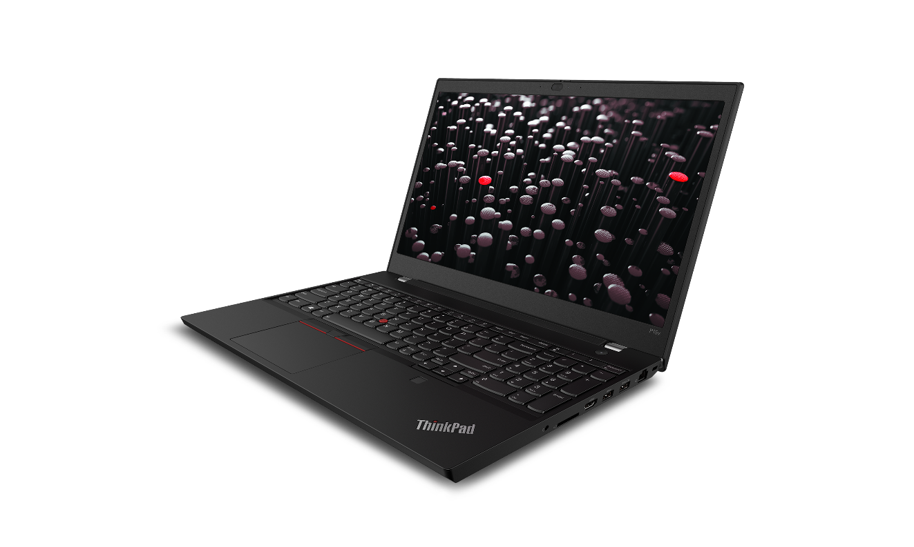
LENOVO TOPSELLER
ThinkPad Mobile Workstations
[ 5 OF 6 ]
P15v Gen2 Performance Value | $2,799 | $1,819 | $2,019 | $2,639
 | 21A9002XUS | 21A9002VUS | 21A90036US | 21A9002WUS
 | Core i7-11850H vPro 8C | Core i5-11400H 6C | Core i7-11850H 8C | Core i7-11850H vPro 8C
 | 32GB DDR4 3200 | 8GB DDR4 3200 | 16GB | 32GB DDR4 3200
 | 1TB PCIe SSD | 512GB PCIe SSD | 512GB PCIe SSD | 1TB PCIe SSD
 | 15.6” FHD 300n IR Cam | 15.6” FHD 300n IR Cam | 15.6” FHD 300n IR Cam | 15.6” FHD 300n IR Cam
 | NVIDIA RTX A2000 4GB | NVIDIA T600 4GB | NVIDIA T600 4GB | NVIDIA T1200 4GB
 | Premier Support | Premier Support | Premier Support | Premier Support
 | 3 Year Warranty | 3 Year Warranty | 3 Year Warranty | 3 Year Warranty
NEW!
P15v Gen2
P15v Gen1 Performance Value | $1,759 | $1,799 | $1,929 | $1,979 | $2,079 | $2,159 | $2,259 | $2,269 | $2,299 | $2,589 | $2,979
 | Rebate $130 | Rebate $130 | Rebate $130 | Rebate $130 | Rebate $130 | Rebate $230 | Rebate $130 | Rebate $130 | Rebate $130 | Rebate $180 | Rebate $230
 | 20TQ0055US | 20TQ002XUS | 20TQ002BUS | 20TQ001LUS | 20TQ0026US | 20TQ002RUS | 20TQ001HUS | 20TQ001WUS | 20TQ001PUS | 20TQ001NUS | 20TQ002EUS
 | Core i7-10750H 6C | Core i5-10300H 4C | Core i7-10750H 6C | Core i7-10750H 6C | Core i7-10850H 6C | Core i7-10750H 6C | Core i7-10850H 6C | Core i7-10750H 6C | Core i7-10850H 6C | Xeon W-10855M 6C | Xeon W-10855M 6C
 | 8GB DDR4 2933 | 16GB DDR4 2933 | 16GB DDR4 2933 | 16GB DDR4 2933 | 16GB DDR4 2933 | 16GB DDR4 2933 | 32GB DDR4 2933 | 32GB DDR4 2933 | 16GB DDR4 2933 | 16GB DDR4 2933 | 32GB DDR4 2933
 | 256GB PCIe SSD | 512GB PCIe SSD | 512GB PCIe SSD | 512GB PCIe SSD | 512GB PCIe SSD | 512GB PCIe SSD | 512GB PCIe SSD | 1TB PCIe SSD | 512GB PCIe SSD | 512GB PCIe SSD | 1TB PCIe SSD
 | 15.6” FHD 300n Touch | 15.6” FHD | 15.6” FHD | 15.6” FHD 300n Touch | 15.6” FHD | 15.6” UHD 4K | 15.6” FHD | 15.6” FHD | 15.6” UHD 4K | 15.6” FHD | 15.6” FHD 300n Touch
 | NVIDIA Quadro P620 | NVIDIA Quadro P620 | NVIDIA Quadro P620 | NVIDIA Quadro P620 | NVIDIA Quadro P620 | NVIDIA Quadro P620 | NVIDIA Quadro P620 | NVIDIA Quadro P620 | NVIDIA Quadro P620 | NVIDIA Quadro P620 | NVIDIA Quadro P620
 |  |  |  |  |  |  | Premier Support
 | 3 Year Warranty | 3 Year Warranty | 3 Year Warranty | 3 Year Warranty | 3 Year Warranty | 3 Year Warranty | 3 Year Warranty | 3 Year Warranty | 3 Year Warranty | 3 Year Warranty | 3 Year Warranty

Slide 7
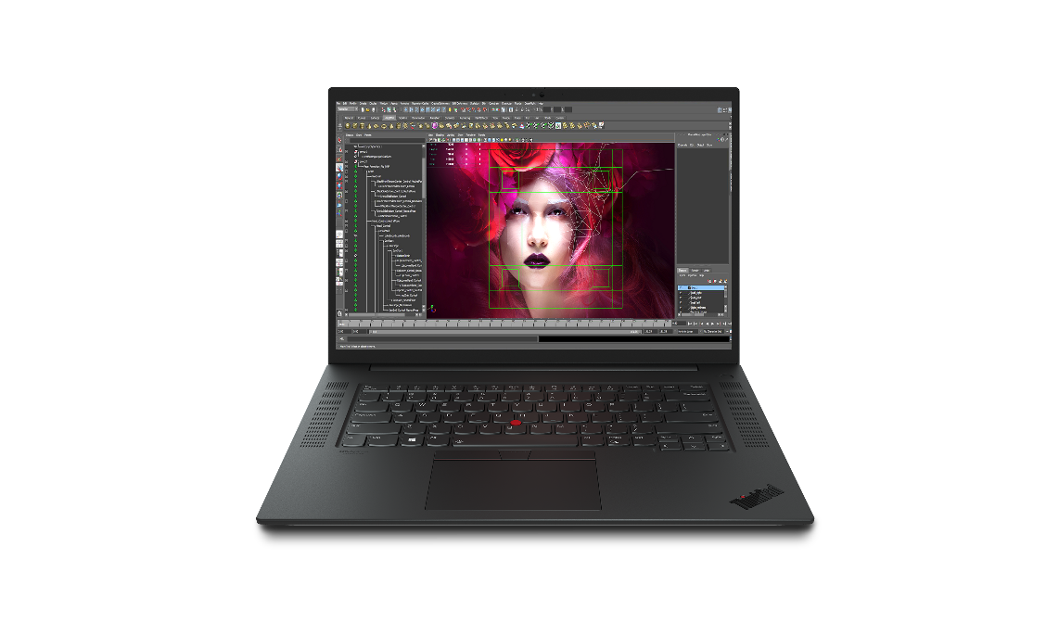
LENOVO TOPSELLER
ThinkPad Mobile Workstations
[ 7 OF 7 ]
P1 Gen4 Ultra-premium performance | $2,319 | $2,569 | $2,689 | $2,799 | $2,939 | $2,979 | $3,199 | $3,919 | $4,199 | $5,189
 | 20Y3003MUS | 20Y3003BUS | 20Y3003LUS | 20Y30038US | 20Y3003CUS | 20Y30033US | 20Y3003NUS | 20Y3003SUS | 20Y3003TUS | 20Y30048US
 | Core i7-11800H 6C | Core i7-11850H 8C | Core i7-11800H 6C | Core i7-11800H 6C | Core i7-11850H 8C | Core i7-11800H 6C | Xeon W-11855M 6C | Core i9-11950H 8C | Core i9-11950H 8C | Core i9-11950H 8C
 | 16GB DDR4 3200 | 16GB DDR4 3200 | 32GB DDR4 3200 | 32GB DDR4 3200 | 32GB DDR4 3200 | 32GB DDR4 3200 | 32GB DDR4 3200 | 32GB DDR4 3200 | 32GB DDR4 3200 | 32GB DDR4 3200
 | 512GB PCIe Gen4 SSD | 512GB PCIe Gen4 SSD | 1TB PCIe Gen4 SSD | 1TB PCIe Gen4 SSD | 1TB PCIe Gen4 SSD | 1TB PCIe Gen4 SSD | 1TB PCIe Gen4 SSD | 1TB PCIe Gen4 SSD | 1TB PCIe Gen4 SSD | 1TB PCIe Gen4 SSD
 | 16" WQXGA (QHD+) IR Cam | 16" WQXGA (QHD+) IR Cam | 16" WQXGA (QHD+) IR Cam | 16" WQUXGA (UHD+) Touch IR Cam | 16" WQXGA (QHD+) IR Cam | 16" WQUXGA (UHD+) Touch IR Cam | 16" WQXGA (QHD+) IR Cam | 16" WQXGA (QHD+) IR Cam | 16" WQUXGA (UHD+) Touch IR Cam | 16" WQXGA (QHD+) IR Cam
 | NVIDIA T1200 | NVIDIA T1200 | NVIDIA RTX A2000 | NVIDIA T1200 | NVIDIA RTX A2000 | NVIDIA RTX A2000 | NVIDIA RTX A2000 | NVIDIA RTX3080 | NVIDIA RTX3080 | NVIDIA RTX A5000
 | Premier Support | Premier Support | Premier Support | Premier Support | Premier Support | Premier Support | Premier Support | Premier Support | Premier Support | Premier Support
 | 3 Year Warranty | 3 Year Warranty | 3 Year Warranty | 3 Year Warranty | 3 Year Warranty | 3 Year Warranty | 3 Year Warranty | 3 Year Warranty | 3 Year Warranty | 3 Year Warranty
NEW!
P1 Gen4
P1 Gen3 Ultra-premium performance | $2,229 | $2,479 | $2,499 | $2,739 | $2,749 | $2,759 | $3,039 | $3,099 | $3,169 | $3,399
 |  | Rebate $25 |  |  | Rebate $25 | Rebate $50 | Rebate $50 | Rebate $25 | Rebate $25 | Rebate $50
 | 20TH000XUS | 20TH000DUS | 20TH003DUS | 20TH0037US | 20TH003BUS | 20TH001GUS | 20TH0034US | 20TH003HUS | 20TH003KUS | 20TH003MUS
 | Core i7-10750H 6C | Core i7-10850H 6C | Core i7-10750H 6C | Core i7-10750H 6C | Core i7-10850H 6C | Core i9-10885H 8C | Core i7-10850H 6C | Core i9-10885H 8C | Xeon W-10855M 6C | Core i9-10885H 8C
 | 16GB DDR4 2933 | 16GB DDR4 2933 | 32GB DDR4 2933 | 32GB DDR4 2933 | 32GB DDR4 2933 | 32GB DDR4 2933 | 32GB DDR4 2933 | 32GB DDR4 2933 | 32GB DDR4 2933 | 32GB DDR4 2933
 | 512GB PCIe SSD | 512GB PCIe SSD | 512GB PCIe SSD | 1TB PCIe SSD | 512GB PCIe SSD | 1TB PCIe SSD | 512GB PCIe SSD | 1TB PCIe SSD | 1TB PCIe SSD | 1TB PCIe SSD
 | 15.6” FHD | 15.6” FHD | 15.6” FHD | 15.6” UHD Non-Touch | 15.6” FHD | 15.6” FHD | 15.6” OLED Touch | 15.6” FHD | 15.6” FHD | 15.6” OLED Touch
 | NVIDIA Quadro T1000 | NVIDIA Quadro T1000 | NVIDIA Quadro T2000 | NVIDIA Quadro T2000 | NVIDIA Quadro T2000 | Intel UHD Graphics | NVIDIA Quadro T2000 | NVIDIA Quadro T2000 | NVIDIA Quadro T2000 | NVIDIA Quadro T2000
 |  |  |  |  |  |  |  | Premier Support |  | Premier Support
 | 3 Year Warranty | 3 Year Warranty | 3 Year Warranty | 3 Year Warranty | 3 Year Warranty | 3 Year Warranty | 3 Year Warranty | 3 Year Warranty | 3 Year Warranty | 3 Year Warranty

Slide 8

LENOVO TOPSELLER
ThinkPad Mobile Workstations
[ 6 OF 7 ]
P15 Gen2 High Performance | $2,199 | $2,459 | $2,589 | $2,619 | $2,839 | $2,949 | $2,999 | $3,059 | $3,099 | $3,119 | $3,229 | $3,849
 | Rebate $ | Rebate $ | Rebate $ | Rebate $ | Rebate $ | Rebate $ | Rebate $ | Rebate $ | Rebate $ | Rebate $ | Rebate $ | Rebate $
 | 20YQ0031US | 20YQ0042US | 20YQ003WUS | 20YQ003AUS | 20YQ0044US | 20YQ003CUS | 20YQ003JUS | 20YQ003FUS | 20YQ0046US | 20YQ003KUS | 20YQ0030US | 20YQ003NUS
 | Core i7-11800H 8C | Core i7-11850H vPro 8C | Core i7-11800H vPro 8C | Core i7-11850H vPro 8C | Core i7-11850H vPro 8C | Xeon W-11855M vPro 6C | Core i7-11850H vPro 8C | Core i9-11950H vPro 8C | Xeon W-11855M vPro 6C | Core i7-11850H vPro 8C | Core i7-11850H vPro 8C | Core i9-11950H vPro 8C
 | 16GB DDR4 3200 | 16GB DDR4 3200 | 32GB DDR4 3200 | 16GB DDR4 3200 | 32GB DDR4 3200 | 32GB DDR4 3200 | 32GB DDR4 3200 | 32GB DDR4 3200 | 32GB DDR4 3200 | 32GB DDR4 3200 | 32GB DDR4 3200 | 32GB DDR4 3200
 | 512GB PCIe Gen4 SSD | 512GB PCIe Gen4 SSD | 1TB PCIe Gen4 SSD | 512GB PCIe Gen4 SSD | 1TB PCIe Gen4 SSD | 1TB PCIe Gen4 SSD | 1TB PCIe Gen4 SSD | 1TB PCIe Gen4 SSD | 1TB PCIe Gen4 SSD | 1TB PCIe Gen4 SSD | 1TB PCIe Gen4 SSD | 1TB PCIe Gen4 SSD
 | 15.6” FHD 500n IR Cam | 15.6” FHD 500n IR Cam | 15.6” FHD 500n IR Cam | 15.6” FHD 500n IR Cam | 15.6” FHD 500n IR Cam | 15.6” FHD 500n IR Cam | 15.6” UHD HDR IR Cam | 15.6” FHD 500n IR Cam | 15.6” FHD 500n IR Cam | 15.6” UHD OLED Touch IR Cam | 15.6” FHD 500n IR Cam | 15.6” FHD 500n IR Cam
 | NVIDIA T1200 | NVIDIA T1200 | NVIDIA RTX A2000 | NVIDIA RTX A2000 | NVIDIA RTX A2000 | NVIDIA T1200 | NVIDIA RTX A2000 | NVIDIA RTX A2000 | NVIDIA RTX A2000 | NVIDIA RTX A2000 | NVIDIA RTX A3000 | NVIDIA RTX A4000
 | 3 Year Warranty | 3 Year Warranty | 3 Year Warranty | 3 Year Warranty | 3 Year Warranty | 3 Year Warranty | 3 Year Warranty | 3 Year Warranty | 3 Year Warranty | 3 Year Warranty | 3 Year Warranty | 3 Year Warranty
 | Premier Support | Premier Support | Premier Support | Premier Support | Premier Support | Premier Support | Premier Support | Premier Support | Premier Support | Premier Support | Premier Support | Premier Support
NEW!
P15 Gen1 High Performance | $2,139 | $2,389 | $2,539 | $2,699 | $2,799 | $2,799 | $2,839 | $2,879 | $2,919 | $2,939 | $3,499 | $3,719
 | Rebate $60 | Rebate $60 | Rebate $160 | Rebate $10 | Rebate $60 | Rebate $60 | Rebate $110 | Rebate $60 | Rebate $110 | Rebate $60 | Rebate $60 | Rebate $110
 | 20ST003XUS | 20ST004DUS | 20ST006FUS | 20ST0048US | 20ST0042US | 20ST0069US | 20ST006KUS | 20ST006GUS | 20ST004GUS | 20ST0050US | 20ST004RUS | 20ST0067US
 | Core i7-10750H 6C | Core i7-10750H 6C | Core i7-10850H 6C | Core i7-10875H 8C | Core i7-10850H 6C | Core i7-10850H 6C | Core i9-10885H 8C | Xeon W-10855M 6C | Core i7-10850H 6C | Core i7-10850H 6C | Core i7-10875H 8C | Core i9-10885H 8C
 | 16GB DDR4 2933 | 32GB DDR4 2933 | 16GB DDR4 2933 | 32GB DDR4 2933 | 32GB DDR4 2933 | 32GB DDR4 2933 | 32GB DDR4 2933 | 16GB DDR4 2933 | 32GB DDR4 2933 | 32GB DDR4 2933 | 32GB DDR4 2933 | 32GB DDR4 2933
 | 512GB PCIe SSD | 512GB PCIe SSD | 512GB PCIe SSD | 512GB PCIe SSD | 512GB PCIe SSD | 1TB PCIe SSD | 512GB PCIe SSD | 512GB PCIe SSD | 512GB PCIe SSD | 512GB PCIe SSD | 512GB PCIe SSD | 1TB PCIe SSD
 | 15.6” FHD | 15.6” FHD | 15.6” FHD | 15.6” FHD | 15.6” UHD Non-Touch | 15.6” FHD | 15.6” FHD | 15.6” FHD | 15.6” OLED Touch | 15.6” FHD | 15.6” FHD | 15.6” FHD
 | NVIDIA Quadro T1000 | NVIDIA Quadro T2000 | NVIDIA Quadro T2000 | NVIDIA Quadro T2000 | NVIDIA Quadro T2000 | NVIDIA Quadro T2000 | NVIDIA Quadro T2000 | NVIDIA Quadro T2000 | NVIDIA Quadro T2000 | NVIDIA Quadro RTX 3000 | NVIDIA Quadro RTX 4000 | NVIDIA Quadro RTX 4000
 |  |  |  |  |  | Premier Support
 | 3 Year Warranty | 3 Year Warranty | 3 Year Warranty | 3 Year Warranty | 3 Year Warranty | 3 Year Warranty | 3 Year Warranty | 3 Year Warranty | 3 Year Warranty | 3 Year Warranty | 3 Year Warranty | 3 Year Warranty

Slide 9
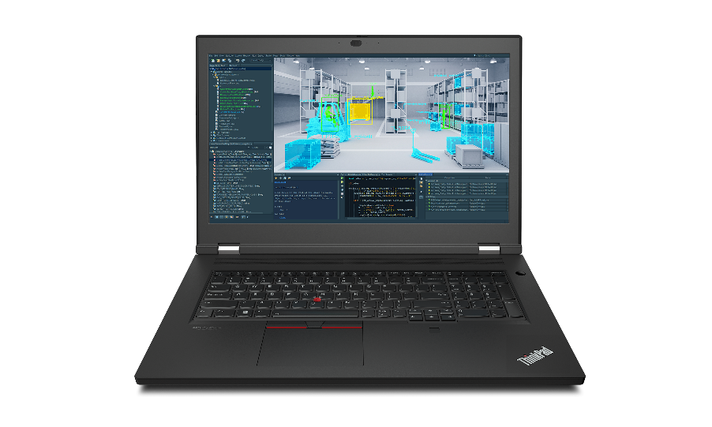
LENOVO TOPSELLER
ThinkPad Mobile Workstations
[ 7 OF 7 ]
P17 Gen2 17” Ultimate Performance | $2,499 | $2,819 | $2,999 | $3,389
 | 20YU001LUS | 20YU001SUS | 20YU001NUS | 20YU001RUS
 | Core i7-1185H vPro 8C | Core i7-1185H vPro 8C | Core i7-1185H vPro 8C | Core i7-1185H vPro 8C
 | 8GB DDR4 3200 | 32GB DDR4 3200 | 32GB DDR4 3200 | 32GB DDR4 3200
 | 512GB PCIe Gen4 SSD | 1TB PCIe Gen4 SSD | 1TB PCIe Gen4 SSD | 1TB PCIe Gen4 SSD
 | 17.3” FHD IR Cam | 17.3” FHD IR Cam | 17.3” FHD IR Cam | 17.3” FHD IR Cam
 | NVIDIA T1200 4GB | NVIDIA T1200 4GB | NVIDIA RTX A2000 4GB | NVIDIA RTX A3000 6GB
 | Premier Support | Premier Support | Premier Support | Premier Support
 | 3 Year Warranty | 3 Year Warranty | 3 Year Warranty | 3 Year Warranty
NEW!
P17 Gen2
P17 Gen1 17” Ultimate Performance | $2,099 | $2,259 | $2,589 | $2,939 | $3,079 | $3,159
 | 20SN003YUS | 20SN0041US | 20SN004PUS | 20SN004TUS | 20SN004SUS | 20SN004NUS
 | Core i7-10750H 6C | Core i7-10750H 6C | Core i7-10850H 6C | Core i9-10885H 8C | Xeon W-10855M 6C | Core i7-10850H 6C
 | 16GB DDR4 2933 | 16GB DDR4 2933 | 16GB DDR4 2933 | 32GB DDR4 2933 | 32GB DDR4 2933 | 32GB DDR4 2933
 | 512GB PCIe SSD | 512GB PCIe SSD | 512GB PCIe SSD | 512GB PCIe SSD | 512GB PCIe SSD | 1TB PCIe SSD
 | 17.3” FHD | 17.3” FHD | 17.3” FHD | 15.6” FHD | 17.3” FHD | 17.3” FHD
 | NVIDIA Quadro T1000 | NVIDIA Quadro T2000 | NVIDIA Quadro T2000 | NVIDIA Quadro T2000 | NVIDIA Quadro T2000 | NVIDIA Quadro RTX 3000
 |  |  | Premier Support | Premier Support | Premier Support | Premier Support
 | 3 Year Warranty | 3 Year Warranty | 3 Year Warranty | 3 Year Warranty | 3 Year Warranty | 3 Year Warranty

Slide 10
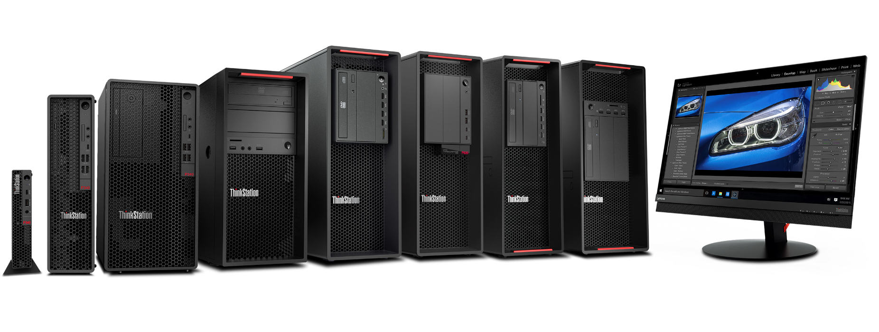
LENOVO TOPSELLER
ThinkStation Workstations
[ 1 OF 5 ]
P340/330 Tiny
World’s Smallest Workstation
P340/330 TWR/SFF
Workstation Power, Desktop Price
P520c
Affordable Performance
P520
Professional-Strength
Power
P620
AMD Threadripper
Pro
P720
Dual Socket Mainstream
P920
Most advanced Dual Socket (CPU) Performance

Slide 11
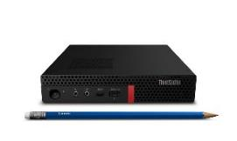
LENOVO TOPSELLER
ThinkStation Workstations
Prices shown do not include rebate (if available).
[ 2 OF 5 ]
P340 Tiny | $1,039 | $1,099 | $1,379 | $1,579 | $1,589 | $1,599 | $1,789 | $1,799 | $1,989
 | Rebate $25 | Rebate $25 | Rebate $25 | Rebate $45 | Rebate $45 | Rebate $25 | Rebate $45 | Rebate $45 | Rebate $45
 | 30DF001CUS | 30DF0019US | 30DF001UUS | 30DF001KUS | 30DF0021US | 30DF001VUS | 30DF001LUS | 30DF001SUS | 30DF001NUS
 | Core i5-10500T 6C | Core i5-10500T 6C | Core i7-10700T 8C | Core i7-10700T 8C | Core i7-10700T 8C | Core i9-10900T 10C | Core i7-10700T 8C | Core i9-10900T 10C | Core i9-10900T 10C
 | 16GB non-ECC | 16GB non-ECC | 16GB non-ECC | 16GB non-ECC | 32GB non-ECC | 16GB non-ECC | 32GB non-ECC | 16GB non-ECC | 32GB non-ECC
 | 512GB PCIe SSD | 256GB PCIe SSD | 512GB PCIe SSD | 512GB PCIe SSD | 1TB PCIe SSD | 512GB PCIe SSD | 1TB PCIe SSD | 512GB PCIe SSD | 1TB PCIe SSD
 | Intel UHD Graphics 630 | NVIDIA Quadro P620 | NVIDIA Quadro P620 | NVIDIA Quadro P1000 | NVIDIA Quadro P620 | NVIDIA Quadro P620 | NVIDIA Quadro P1000 | NVIDIA Quadro P1000 | NVIDIA Quadro P1000
 |  |  |  |  | Premier Support | Premier Support | Premier Support | Premier Support | Premier Support
 | Win 10 Pro | Win 10 Pro | Win 10 Pro | Win 10 Pro | Win 10 Pro | Win 10 Pro | Win 10 Pro | Win 10 Pro | Win 10 Pro
 | 3 Year Onsite | 3 Year Onsite | 3 Year Onsite | 3 Year Onsite | 3 Year Onsite | 3 Year Onsite | 3 Year Onsite | 3 Year Onsite | 3 Year Onsite
World’s Smallest Workstation
Big Performance & Reliability
P340 SFF | $1,009 | $1,169 | $1,369 | $1,529 | $1,569 | $1,569 | $1,689 | $1,769 | $1,769 | $1,889 | $2,089
 |  | Rebate $75 | Rebate $120 | Rebate $150 | Rebate $100 | Rebate $20 | Rebate $160 | Rebate $180 | Rebate $50 | Rebate $100 | Rebate $50
 | 30DK000RUS | 30DK000MUS | 30DK003RUS | 30DK003PUS | 30DK003UUS | 30DK003XUS | 30DK003QUS | 30DK0008US | 30DK0041US | 30DK003TUS | 30DK0040US
 | Core i5-10500 6C | Core i5-10500 6C | Core i7-10700 8C | Core i7-10700 8C | Core i7-10700 8C | Core i9-10900 10C | Core i7-10700 8C | Xeon W-1250 6C | Core i9-10900 10C | Core i7-10700 8C | Core i9-10900 10C
 | 8GB non-ECC | 16GB non-ECC | 16GB non-ECC | 16GB non-ECC | 32GB non-ECC | 16GB non-ECC | 16GB non-ECC | 16GB non-ECC | 32GB non-ECC | 32GB non-ECC | 32GB non-ECC
 | 256GB PCIe SSD | 512GB PCIe SSD | 512GB PCIe SSD | 512GB PCIe SSD | 1TB PCIe SSD | 512GB PCIe SSD | 512GB PCIe SSD | 512GB PCIe SSD | 1TB PCIe SSD | 1TB PCIe SSD | 1TB PCIe SSD
 | Intel HD Graphics Open to add graphics | Intel HD Graphics Open to add graphics | Intel HD Graphics Open to add graphics | NVIDIA Quadro P620 | Intel HD Graphics Open to add graphics | Intel HD Graphics Open to add graphics | NVIDIA Quadro P1000 | NVIDIA Quadro P1000 | Intel HD Graphics Open to add graphics | NVIDIA Quadro P1000 | NVIDIA Quadro P1000
 |  |  |  |  | Premier Support |  |  |  | Premier Support | Premier Support | Premier Support
 | Win 10 Pro | Win 10 Pro | Win 10 Pro | Win 10 Pro | Win 10 Pro | Win 10 Pro | Win 10 Pro | Win 10 Pro | Win 10 Pro | Win 10 Pro | Win 10 Pro
 | 3 Year Onsite | 3 Year Onsite | 3 Year Onsite | 3 Year Onsite | 3 Year Onsite | 3 Year Onsite | 3 Year Onsite | 3 Year Onsite | 3 Year Onsite | 3 Year Onsite | 3 Year Onsite

Slide 12
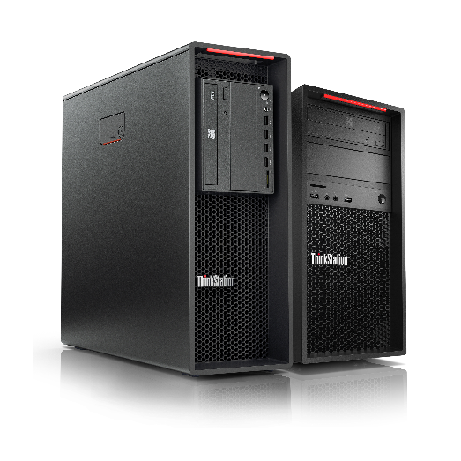
LENOVO TOPSELLER
ThinkStation Workstations
Prices shown do not include rebate (if available).
[ 3 OF 5 ]
P340 Tower | $1,109 | $1,409 | $1,499 | $1,589 | $1,709 | $1,719 | $1,899 | $2,469 | $4,149
 | Rebate $40 | Rebate $150 | Rebate $150 | Rebate $140 | Rebate $200 | Rebate $100 | Rebate $240 | Rebate $290 | Rebate $320
 | 30DH000NUS | 30DH00JAUS | 30DH00JEUS | 30DH00JCUS | 30DH00J3US | 30DH00JSUS | 30DH00K5US | 30DH00J8US | 30DH00K4US
 | Core i5-10500 6C 500W | Core i7-10700 8C 500W | Core i7-10700K 8C 500W | Core i7-10700 8C | Core i7-10700 8C | Core i9-10900 10C | Core i9-10900K 10C | Core i7-10700 8C | Core i9-10900K 10C
 | 16GB non-ECC | 16GB non-ECC | 16GB non-ECC | 32GB non-ECC | 16GB non-ECC | 32GB non-ECC | 32GB non-ECC | 16GB non-ECC | 32GB non-ECC
 | 512GB PCIe SSD | 512GB PCIe SSD | 512GB PCIe SSD | 1TB PCIe SSD | 512GB PCIe SSD | 512GB PCIe SSD | 1TB PCIe SSD | 512GB PCIe SSD | 1TB PCIe SSD
 | Intel HD Graphics Open to add graphics | Intel HD Graphics Open to add graphics | Intel HD Graphics Open to add graphics | Intel HD Graphics Open to add graphics | NVIDIA Quadro P1000 | Intel HD Graphics Open to add graphics | Intel HD Graphics Open to add graphics | NVIDIA Quadro RTX 4000 | NVIDIA Quadro RTX 5000
 |  |  |  | Premier Support |  | Premier Support | Premier Support | Premier Support | Premier Support
 | Win 10 Pro | Win 10 Pro | Win 10 Pro | Win 10 Pro | Win 10 Pro | Win 10 Pro | Win 10 Pro | Win 10 Pro | Win 10 Pro
 | 3 Year Onsite | 3 Year Onsite | 3 Year Onsite | 3 Year Onsite | 3 Year Onsite | 3 Year Onsite | 3 Year Onsite | 3 Year Onsite | 3 Year Onsite
P520c Workstation | $1,389 | $1,609 | $2,809
 | Rebate $80 | Rebate $80 | Rebate $80
 | 30BX00CVUS | 30BX00D2US | 30BX00D3US
 | Xeon W-2223 4 Cores | Xeon W-2225 4 Cores | Xeon W-2225 4 Cores
 | 625W PSU | 625W PSU | 625W PSU
 | 16GB ECC | 16GB ECC | 32GB ECC
 | 512GB PCle SSD | 512GB PCle SSD | 1TB PCle SSD
 | Choose Graphics | Choose Graphics | NVIDIA Quadro RTX 4000
 | Win 10 Pro 64 | Win 10 Pro 64 | Win 10 Pro 64
 | 3 Year Premier | 3 Year Premier | 3 Year Premier
P520 Workstation | $1,709 | $2,399 | $2,979
 | Rebate $150 | Rebate $150 | Rebate $150
 | 30BE00JAUS | 30BE00JCUS | 30BE00J0US
 | Xeon W-2225 4 Cores | Xeon W-2245 8 Cores | Xeon W-2235 6 Cores
 | 690W PSU | 1000W PSU | 690W PSU
 | 16GB ECC | 32GB ECC | 16GB ECC
 | 512GB PCle SSD | 1TB PCle SSD | 512GB PCle SSD
 | Choose Graphics | Choose Graphics | NVIDIA Quadro RTX 4000
 | Win 10 Pro 64 | Win 10 Pro 64 | Win 10 Pro 64
 | 3 Year Premier | 3 Year Premier | 3 Year Premier

Slide 13
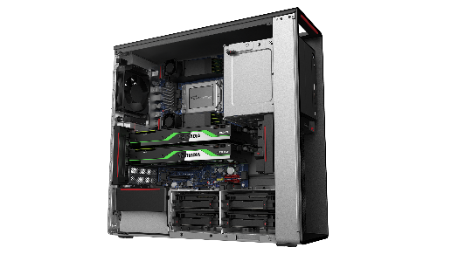
LENOVO TOPSELLER
ThinkStation Workstations
[ 4 OF 5 ]
ThinkStation P620 +
AMD Threadripper Pro
Uniquely ThinkStation, best-of-breed pro performance for:
  Digital Artists
  Engineers
  Life Scientists
  Software Developers
  Data Specialists
Now available with latest PCIe Gen 4-optimized NVIDIA RTX Ampere graphics and fastest-available PCIe Gen 4 storage
Up to 64 processor cores on a single socket*
P620 Workstation | $2,259 | $2,859 | $2,849 | $3,979
 | Rebate $50 | Rebate $50 | Rebate $50 | Rebate $50
 | 30E0003TUS | 30E00033US | 30E0005AUS | 30E0004TUS
 | Threadripper Pro 3945WX 12 cores | Threadripper Pro 3955WX 16 cores | Threadripper Pro 3945WX 12 cores | Threadripper Pro 3955WX 16 cores
 | 1000W PSU | 1000W PSU | 1000W PSU | 1000W PSU
 | 16GB ECC | 16GB ECC | 32GB ECC | 32GB ECC
 | 512GB PCle Gen3 SSD | 512GB PCle Gen3 SSD | 512GB PCle Gen3 SSD | 512GB PCle Gen3 SSD
 | Choose Graphics | Choose Graphics | NVIDIA Quadro P2200 5GB | NVIDIA Quadro RTX 4000 8GB
 | Win 10 Pro 64 | Win 10 Pro 64 | Win 10 Pro 64 | Win 10 Pro 64
 | 3 Year Premier | 3 Year Premier | 3 Year Premier | 3 Year Premier
While supplies last on these models
P620 Workstation | $2,949 | $3,549 | $4,239 | $5,509 | $5,939 | $9,329 | $11,589
 | 30E0008SUS | 30E0008XUS | 30E0008QUS | 30E000B2US | 30E000ARUS | 30E0008NUS | 30E00097US
 | Threadripper Pro 3945WX 12 cores | Threadripper Pro 3955WX 16 cores | Threadripper Pro 3955WX 16 cores | Threadripper Pro 3945WX 12 cores | Threadripper Pro 3955WX 16 cores | Threadripper Pro 3955WX 16 cores | Threadripper Pro 3975WX 32 cores
 | 1000W PSU | 1000W PSU | 1000W PSU | 1000W PSU | 1000W PSU | 1000W PSU | 1000W PSU
 | 32GB ECC | 32GB ECC | 32GB ECC | 32GB ECC | 64GB ECC | 64GB ECC | 64GB ECC
 | 1TB PCle Gen4 SSD | 1TB PCle Gen4 SSD | 1TB PCle Gen4 SSD | 1TB PCle Gen4 SSD | 1TB PCle Gen4 SSD | 1TB PCle Gen4 SSD | 1TB PCle Gen4 SSD
 | NVIDIA Quadro P1000 4GB | NVIDIA Quadro P1000 4GB | NVIDIA Quadro RTX 4000 8GB | NVIDIA RTX A5000 24GB | NVIDIA RTX A5000 24GB | NVIDIA RTX A6000 48GB | NVIDIA RTX A6000 48GB
 | Win 10 Pro 64 | Win 10 Pro 64 | Win 10 Pro 64 | Win 10 Pro 64 | Win 10 Pro 64 | Win 10 Pro 64 | Win 10 Pro 64
 | 3 Year Premier | 3 Year Premier | 3 Year Premier | 3 Year Premier | 3 Year Premier | 3 Year Premier | 3 Year Premier
P720 2P Workstation | $2,549 | $3,009
 | Rebate $145 | Rebate $145
 | 30BA00H7US | 30BA00HBUS
 | 1x Xeon Silver 4214R 12C | 2x Xeon Silver 4210R 10C
 | 1000W PSU | 1000W PSU
 | 16GB ECC | 32GB ECC
 | 512GB PCIe SSD | 1TB PCIe SSD
 | No ODD | No ODD
 | Choose Graphics | Choose Graphics
 | Win 10 Pro 64 | Win 10 Pro 64
 | 3 Year Premier | 3 Year Premier
P920 2P Workstation | $2,699 | $3,269
 | Rebate $110 | Rebate $110
 | 30BC005QUS | 30BC005NUS
 | 1x Xeon Silver 4214R 12C | 2x Xeon Silver 4210R 10C
 | 1400W PSU | 1400W PSU
 | 16GB ECC | 32GB ECC
 | 512GB PCIe SSD | 512GB PCIe SSD
 | No ODD | No ODD
 | Choose Graphics | Choose Graphics
 | Win 10 Pro 64 | Win 10 Pro 64
 | 3 Year Premier | 3 Year Premier
*3995WX 64c CPU via CTO

Slide 14
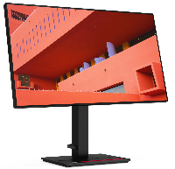

Attach and Upgrade Options for Workstations
LENOVO TOPSELLER
ThinkStation Workstations
[ 5 OF 5 ]
Prices shown do not include rebate (if available).
Attach Performance Displays – Lenovo’s Best!
24 inch | $304 P24q-20 61F5GAR1US 23.8-inch QHD No USB-C Daisy chain capable | P24h-2L 62B2GAR1US 23.8-inch QHD 2560x1440 USB-C (up to 70w) Daisy chain capable
27 inch | $404 P27q-20 61EAGAR6US 27-inch QHD 4-sided near-edgeless 2560x1440 Daisy chain capable | $504 P27h-20 61E9GAR6US 27-inch QHD 4-sided near-edgeless USB-C (90W) Integrated RJ45 Daisy chain capable
32 inch / 34 inch | $1,034 P32p-20 62A2GAR2US 32-inch 4K UHD USB-C (up 90W) Integrated RJ45 Integrated phone holder stand | P32p-20 62A2GAR2US 34.4-inch WLED 3440x1440 USB-C (up to 100W) Daisy chain capable
P330/P340 SFF Graphics
$139 4X60N86656 NVIDIA Quadro P400 2GB | $249 4X60R60469 NVIDIA Quadro P620 2GB
$419 4X60N86660 NVIDIA Quadro P1000 4GB
P620/P520/P720/P920 Graphics
$249.99 4X60R60468 NVIDIA Quadro P620 | $419.99 4X60N86661 NVIDIA Quadro P1000 4GB
$2,499.99 4X60U98733 NVIDIA Quadro RTX 5000 16GB | $1,149.99 4X60Z97113 NVIDIA Quadro RTX 4000 8GB
$7,499.99 4X60X01143 NVIDIA Quadro RTX 8000 48GB | $5,249.99 4X60V13556 NVIDIA Quadro RTX 6000 24GB
$1,099.99 4X61A22496 NVIDIA GeForce RTX2080 Super 8GB | $11,999.99 4X60T45045 NVIDIA Quadro GV100 32GB
 | $1,249.99 4X61C56103 NVIDIA GeForce RTX 3080 10GB P620/P520 only
P340/P520c TWR Graphics
$249.9 4X60R60468 NVIDIA Quadro P620 2GB | $419.99 4X60N86661 NVIDIA Quadro P1000 4GB
 | $1,149.99 4X60Z97113 NVIDIA Quadro RTX 4000 8GB
P27h-20

