Slide 1
Onward
Image recommendations for e-book localization

Slide 2
e-books for localization
Imagery recommendations
Our criteria for selecting e-book cover images:
Must differentiate from the cover of the customer story for that same market
Need to be a hero-quality, retouched image
Please note: Because our library of retouched imagery is limited, there are some cases in which we are suggesting that we pick up a photo from the interior of the e-book, then we made a recommendation for what image should go in its place. Those images are provided as thumbnails and with a blue outline.

Slide 3
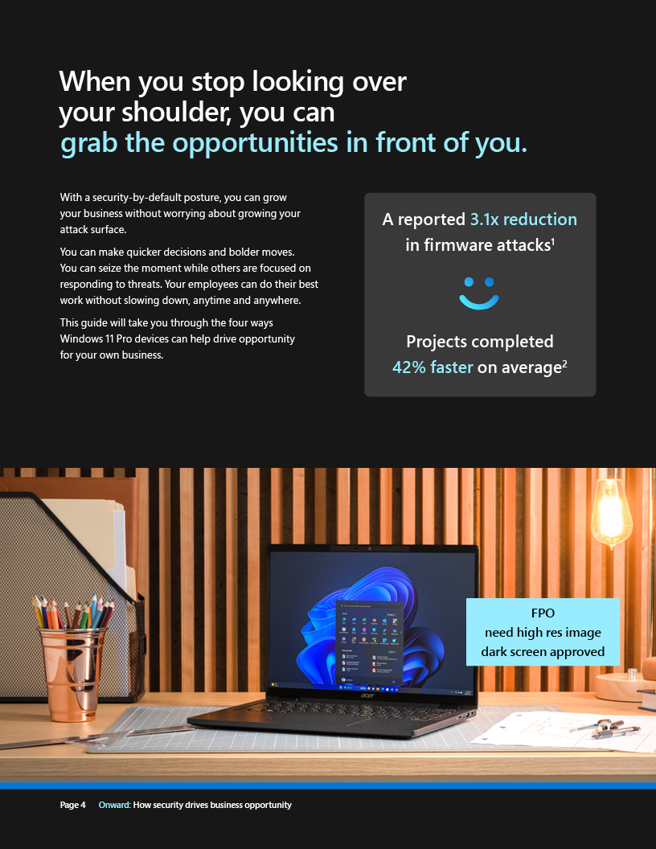
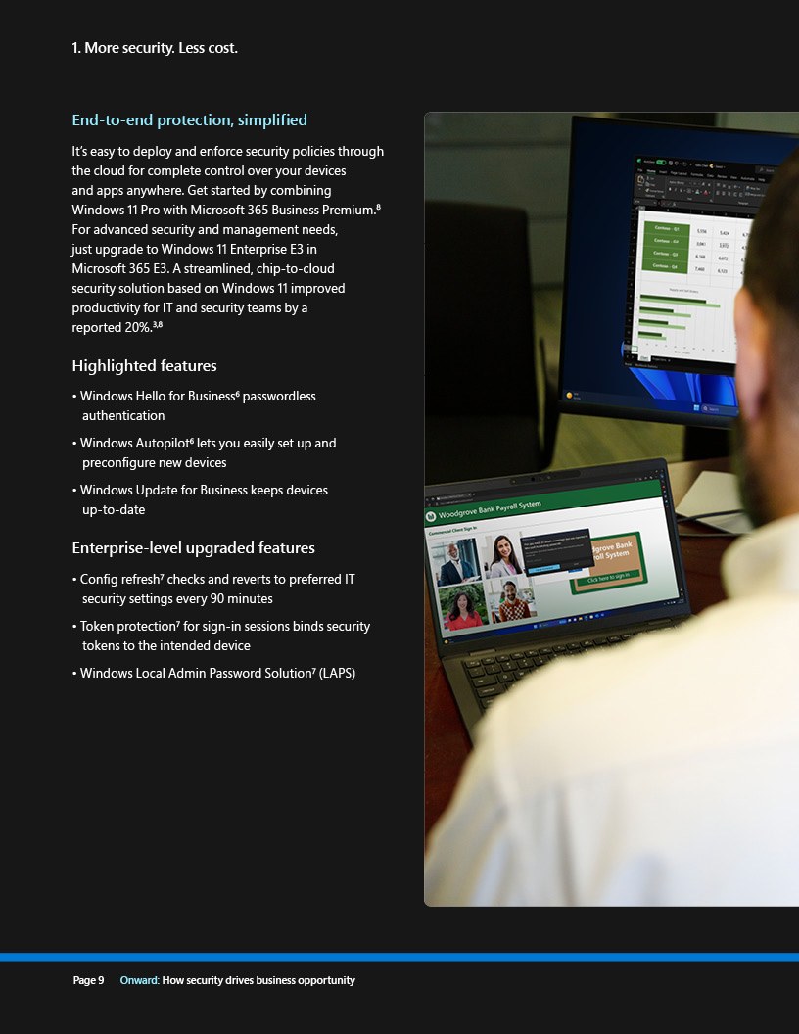
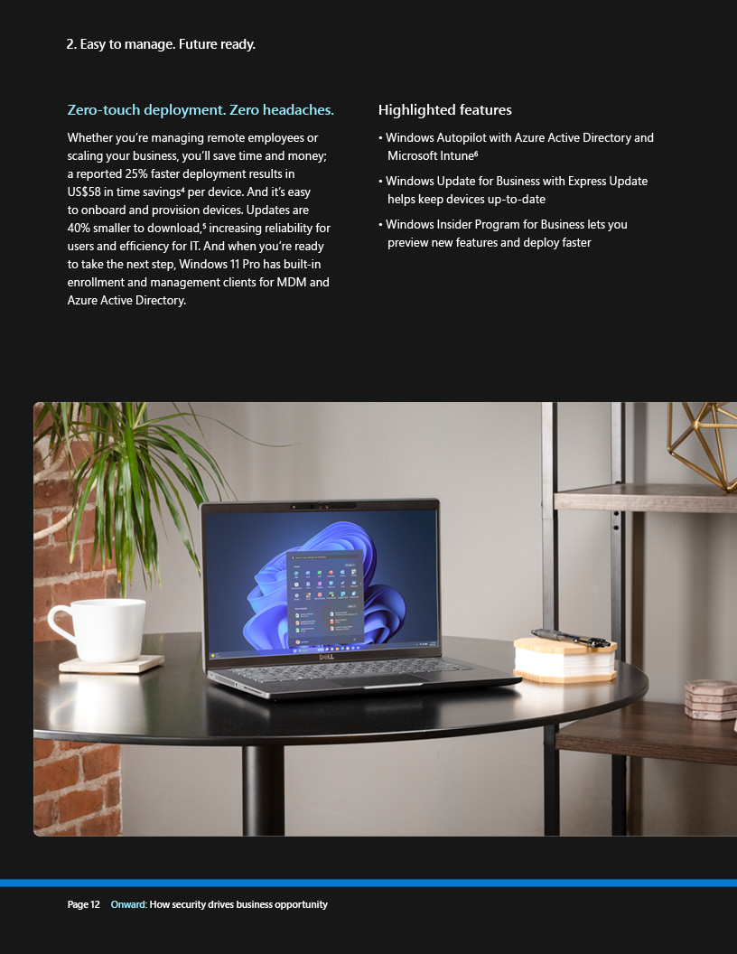
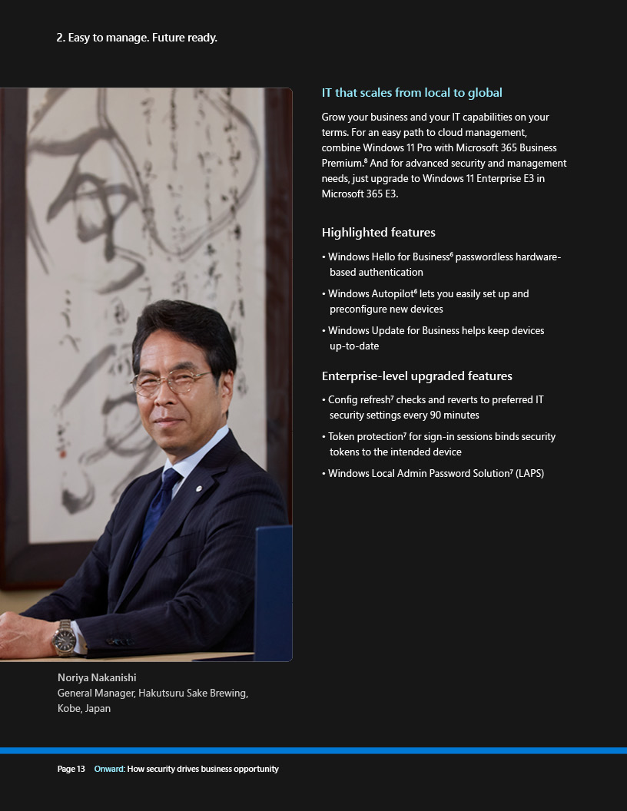
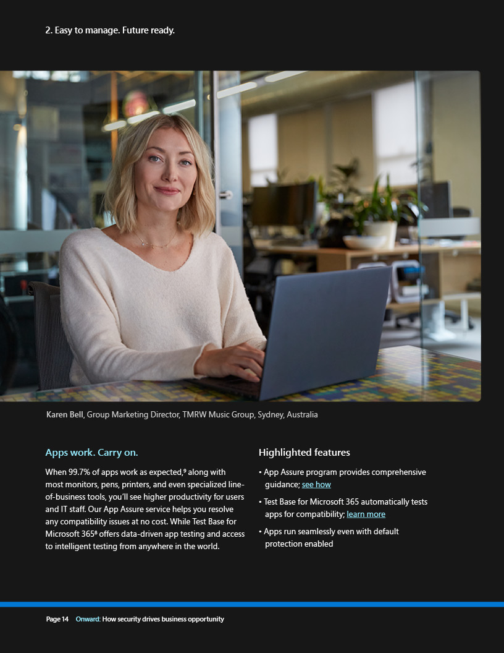
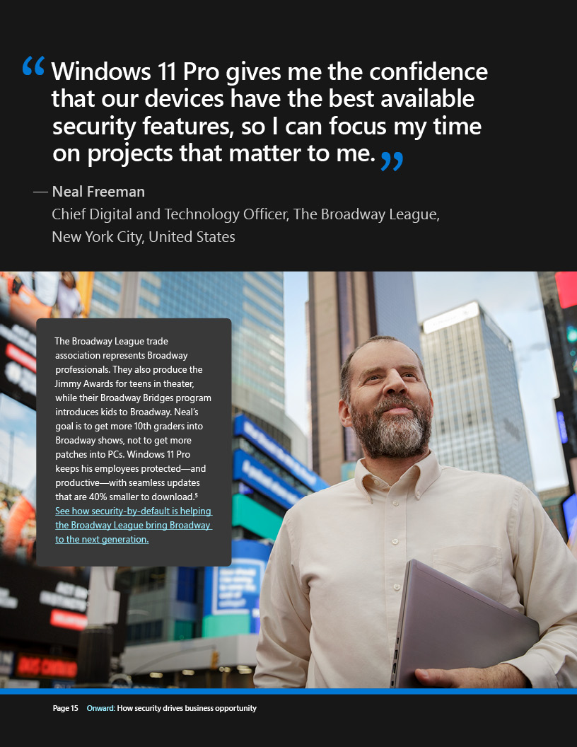
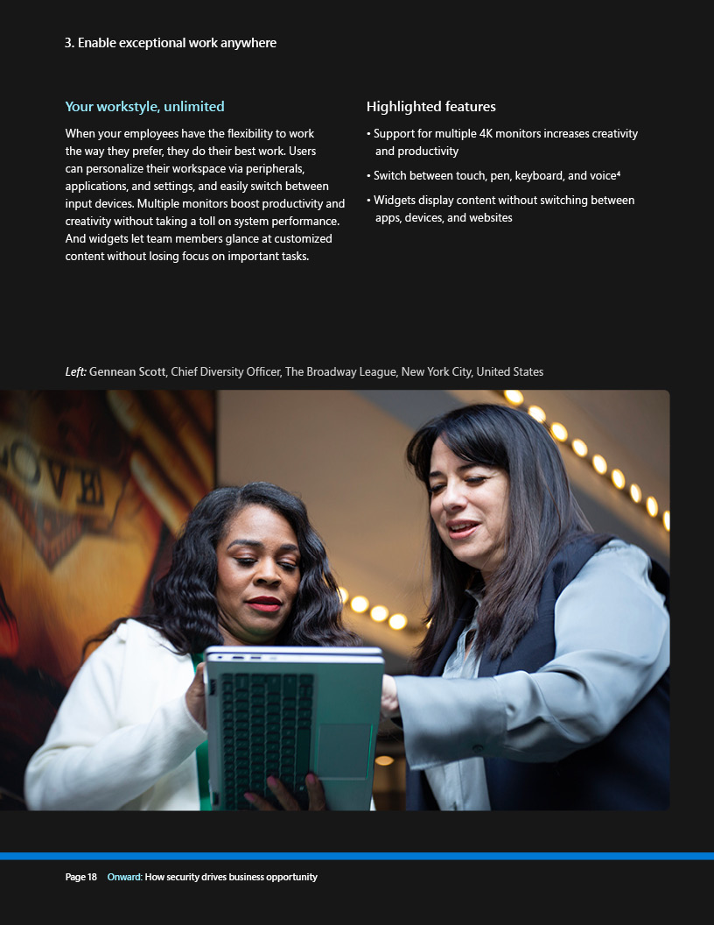
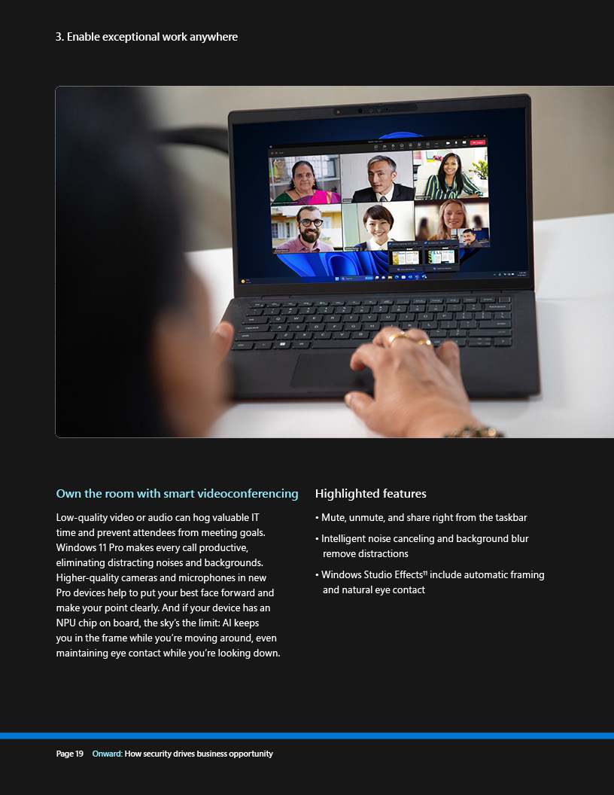
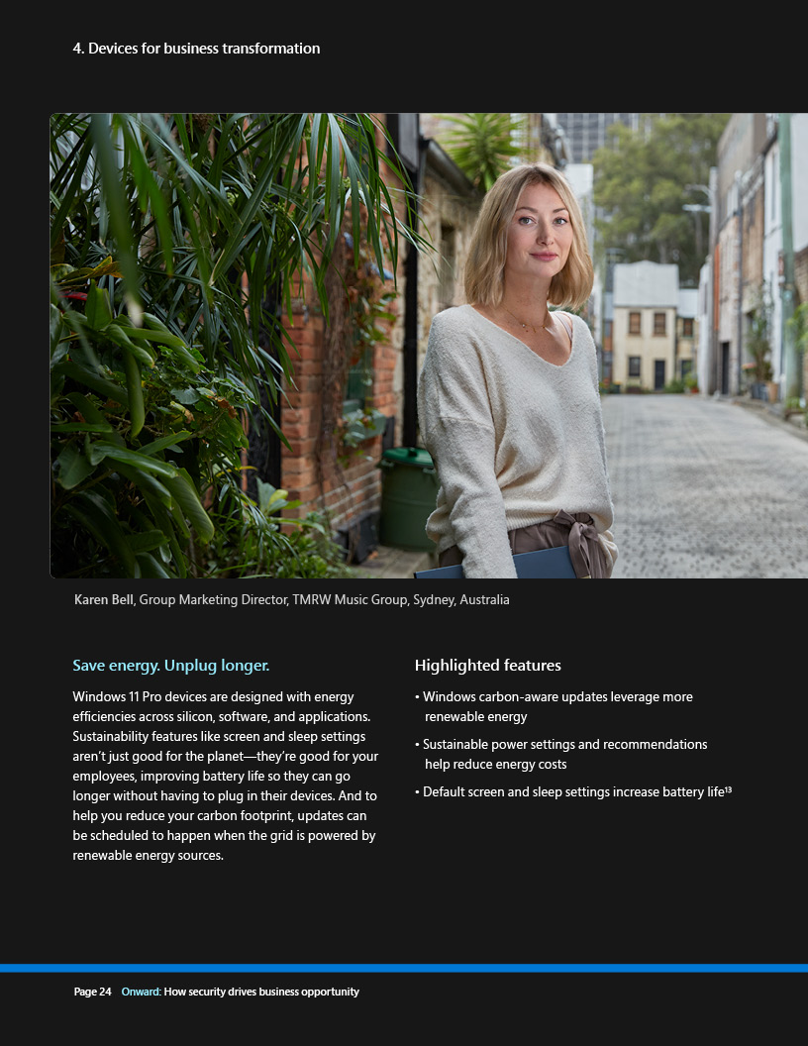
NYC e-book
For context

Slide 4
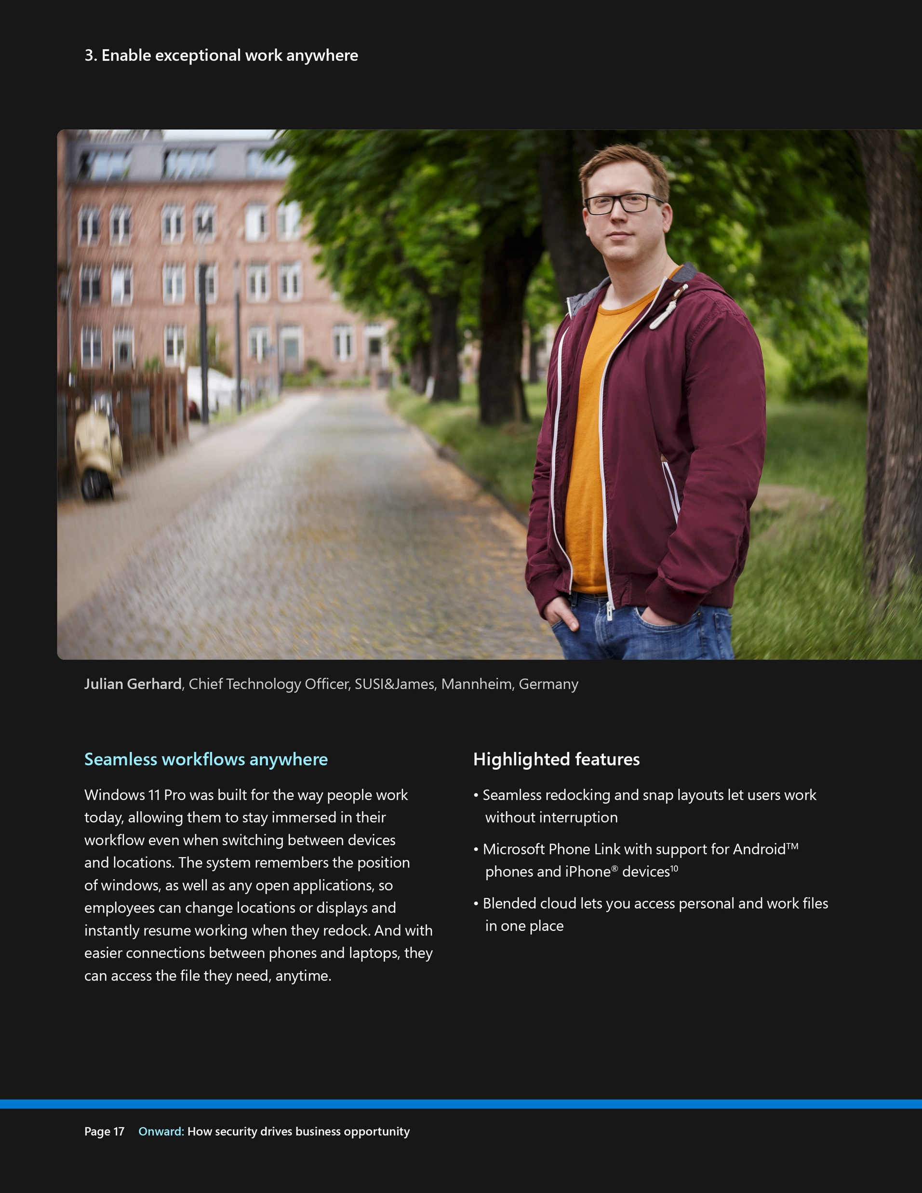
UK e-book

Slide 5
Germany e-book

Slide 6
India e-book

Slide 7
Japan e-book

Slide 8
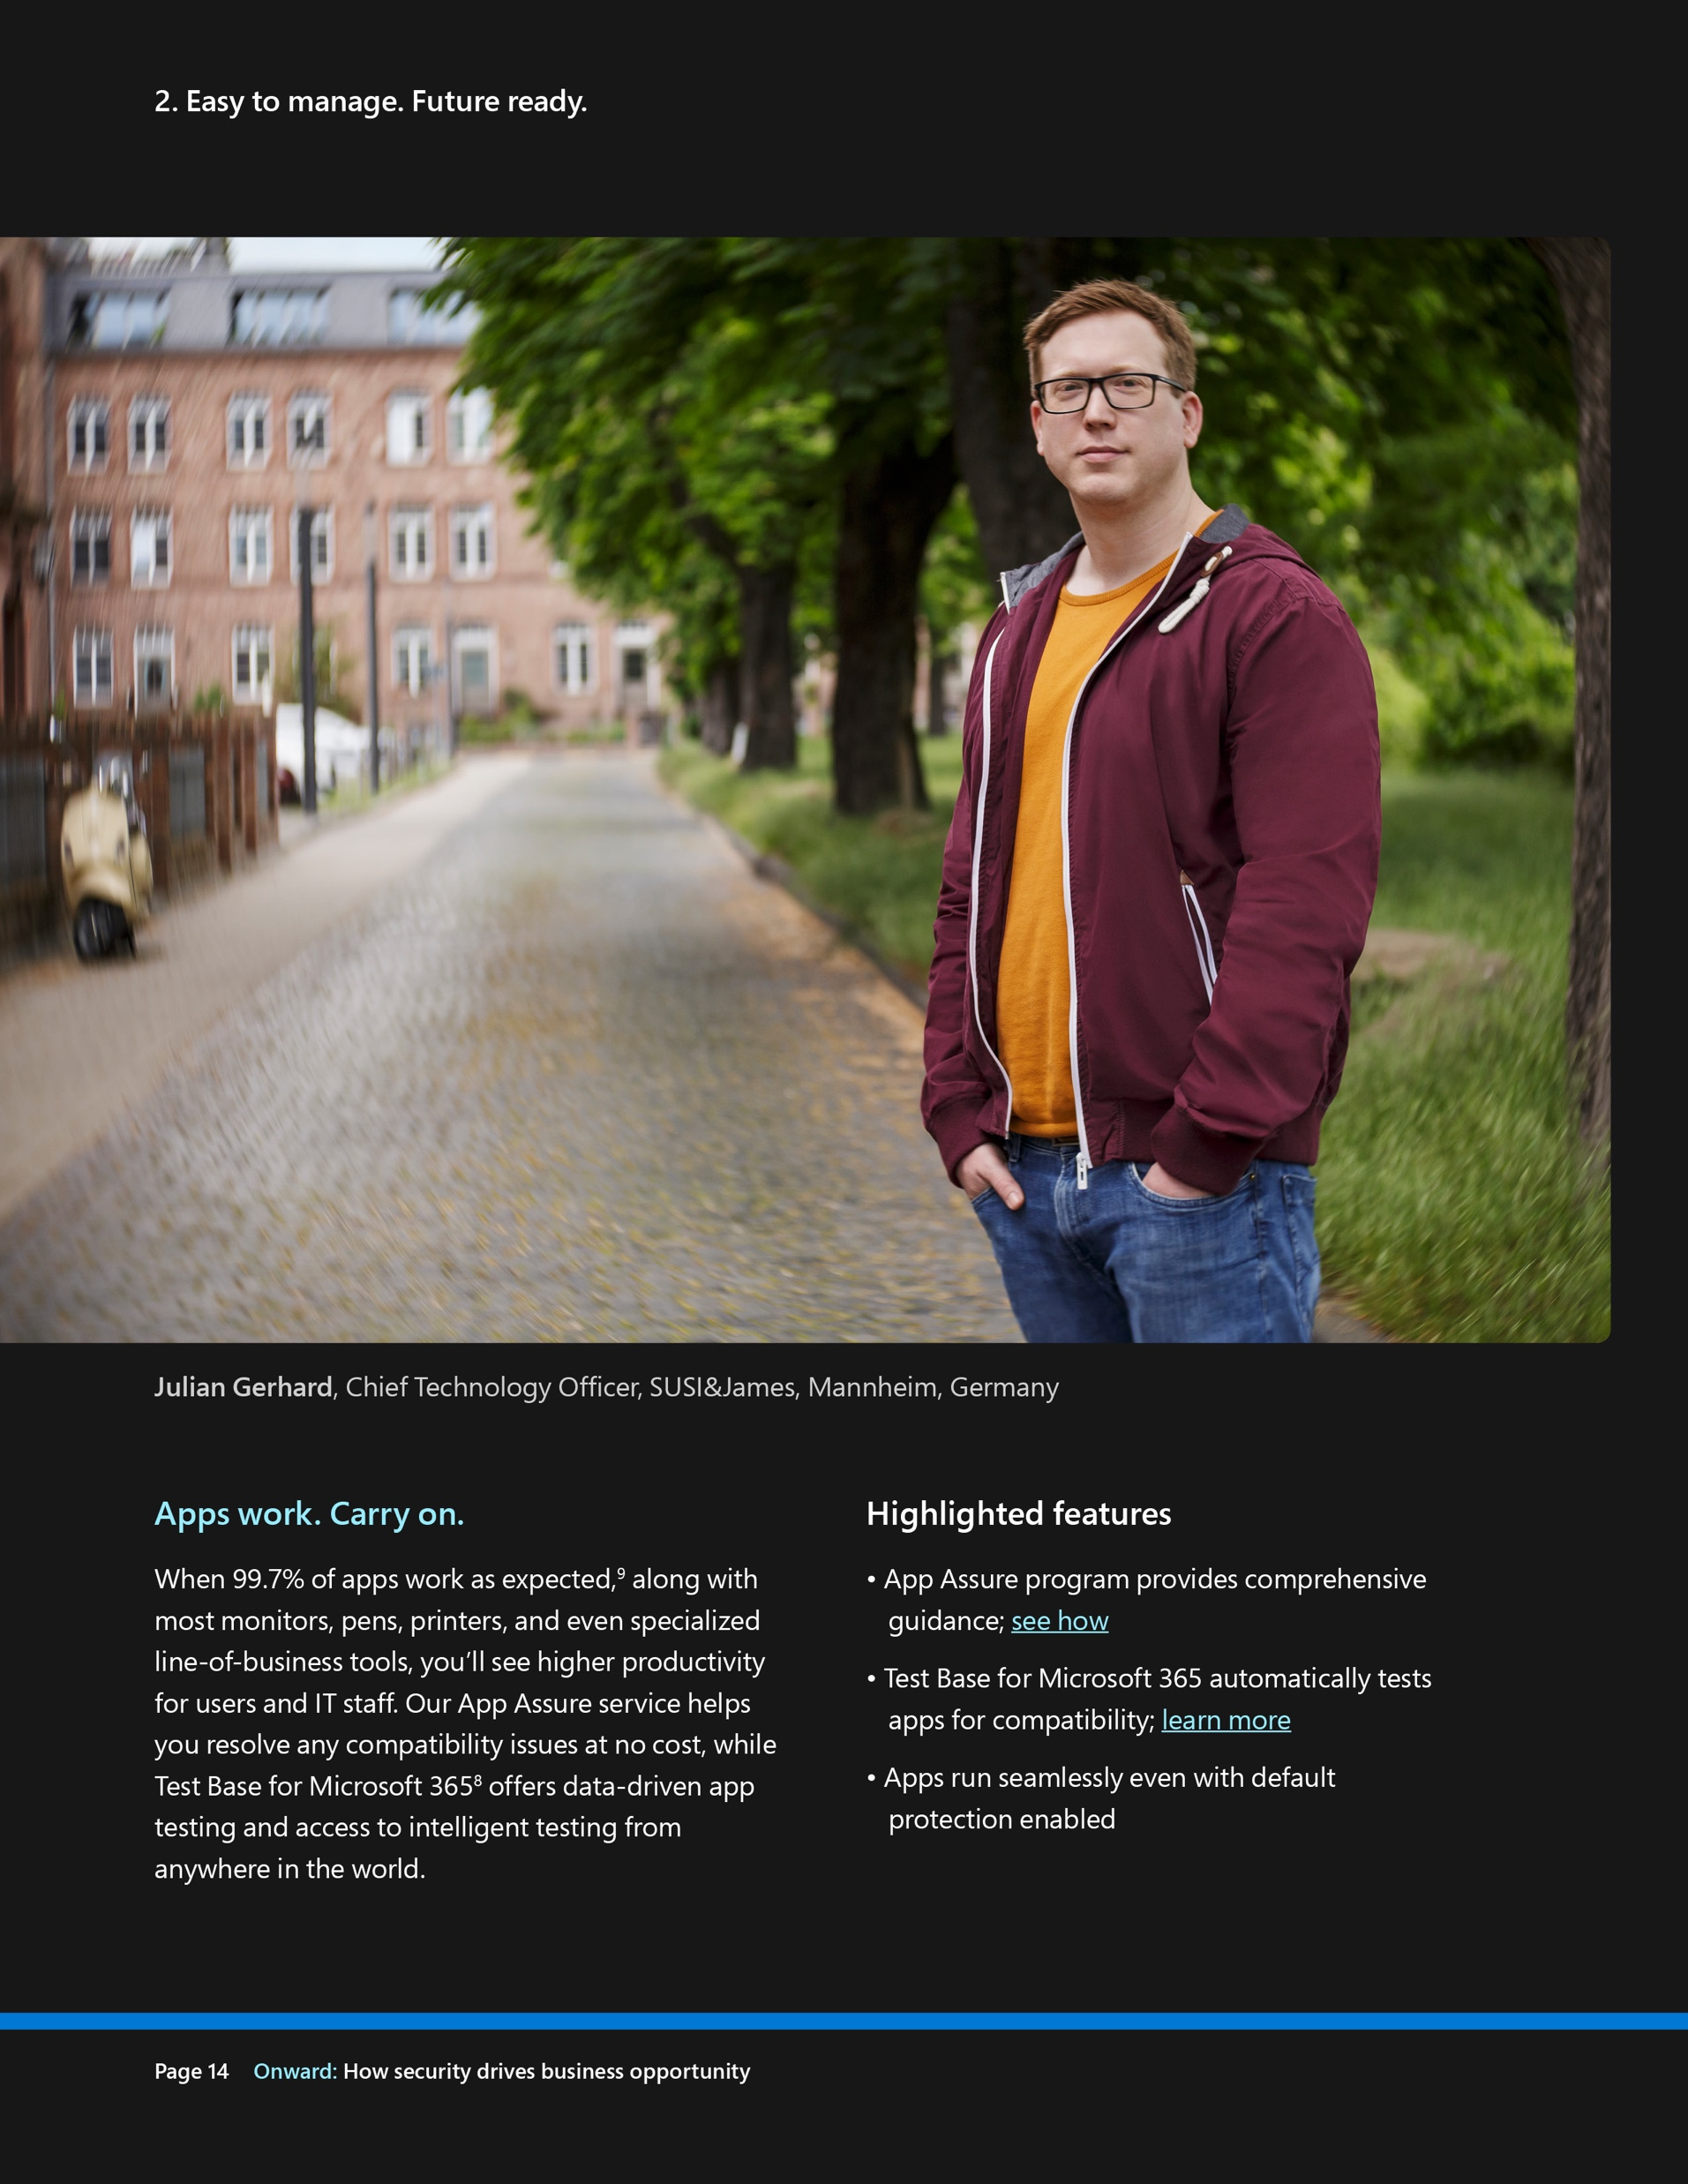
Australia e-book

Slide 9
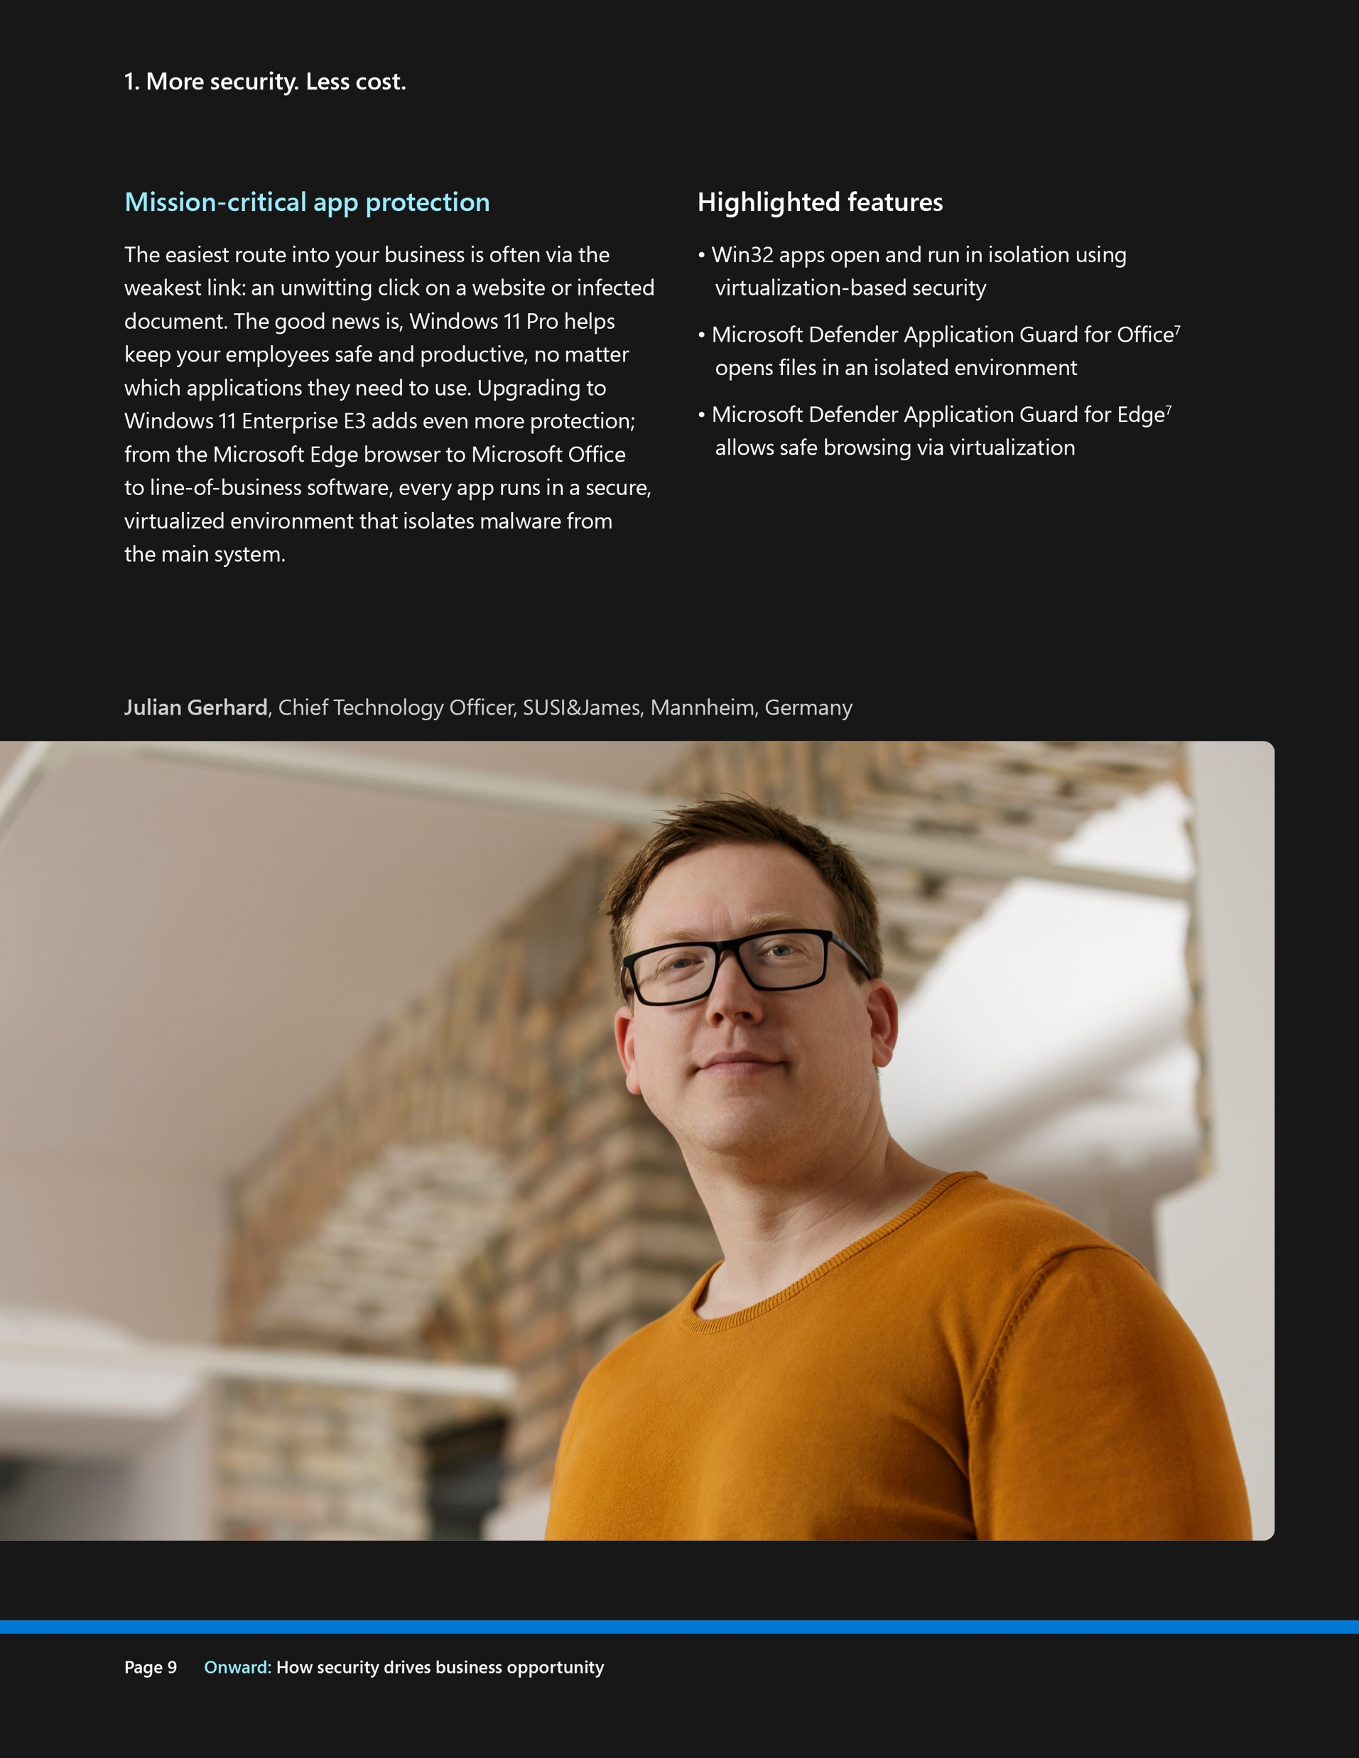
Canada e-book rd2

Slide 10
Thank you

