Slide 1
Esports | Frames Win Games
Q1’20 Training

Slide 2
Esports is MASSIVE
100M Unique Worlds Viewers
440M Unique Esports Viewers Globally
Esports at Olympics 2020
$34 million TI prize pool
Notes:
Esports is massive. A 1.1B dollar industry. League of Legends Worlds broke 100M unique viewers, Overwatch League continues to attract top tier brands and boats a 50M dollar franchising fee, Streetfighter and Rocket League will be in the 2020 Olympics (thanks in part to Intel), and the Internationally added roughly 10 more million dollars to the price pool this year topping out at $34M in prices.
Esports is a massive growing segment of the gaming industry. But Esports games are not just enjoyed by the pros…
Note – Super Bowl 2019 was only 98M viewers. Worlds tops American Football!
Sources:
$1.1B - https://www.reuters.com/article/us-videogames-outlook/global-esports-revenues-to-top-1-billion-in-2019-report-idUSKCN1Q11XY
League Worlds Viewers- https://www.riftherald.com/2018/12/11/18136237/riot-2018-league-of-legends-world-finals-viewers-prize-pool
Olympics 2020 - https://esportsinsider.com/2019/09/intel-world-open-olympics/
TI9 Prize pool - https://dota2.prizetrac.kr/international2019
Overwatch Buy In - https://www.bloomberg.com/news/articles/2018-05-03/activision-gives-tepid-earnings-outlook-as-fortnite-threat-looms

Slide 3
GeForce is the Platform for Esports
99% of Esports Athletes Play on GeForce
NVIDIA GeForce
Other
Source: Prosettings.net
Notes:
GeForce is the Esports Platform
99% of Pros play on GeForce
All Major tournaments are played on GeForce

Slide 4
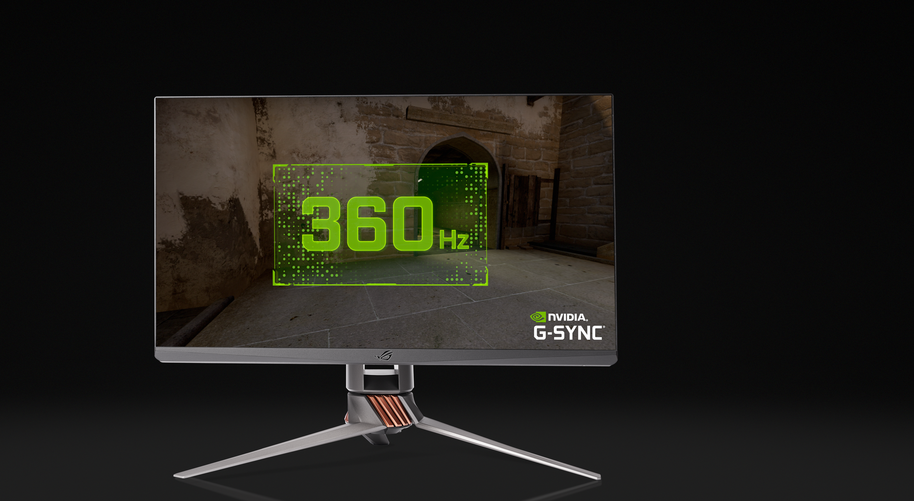
NEW G-SYNC ESPORTS DISPLAYS
Breakthrough 360Hz Design for Competitive Gaming
24.5” 1080p, 360Hz refresh rate
Minimal ghosting with custom tuned dynamic overdrive
Advanced G-SYNC processor
AU Optronics LCD panel
ASUS ROG Swift 360Hz
Notes:
At NVIDIA, we are continuously developing products that unlock the potential of esports athletes and competitive gamers. Today, we are announcing the next generation of Esports technology – 360Hz, powered by NVIDIA G-SYNC. Together with our partners at ASUS and AUO, we have built a display that can refresh the entire display in under 2.8ms. This display is specifically designed for competitive gamer – 360hz for maximum smoothness and a 24.5 inch form factor to keep every pixel of action in your field of view. Additionally, our advanced G-SYNC display processor provides variable refresh rates with custom tuned dynamic overdrive to ensure a ghost-free experience throughout the entire VRR range (1-360Hz).

Slide 5
GeForce Gamers are Competitive
Play to Win and Master the Game
Non-Competitive Gamers
Competitive Gamers
76%
OF GEFORCE GAMERS PLAY COMPETITIVE GAMES EACH MONTH!
Both Charts: GeForce Experience Data, 76% is the percentage of players that play a multi-player competitive game every week. Source: NVIDIA
Notes:
We often focus on the single player experiences that push the limits on graphics – which is great, but there is a large amount of our GeForce gamers that play competitive games. Competitive games are games that are primarily player vs. player combat focused, pitting one players skills vs. the other. Any competitive advantage can help tips the scales in the players favor.
The chart on the left shows that 8 out of the top 10 games on GFE are competitive.
76% of gamers play a competitive game each month.

Slide 6
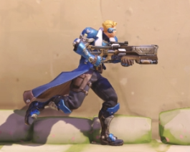
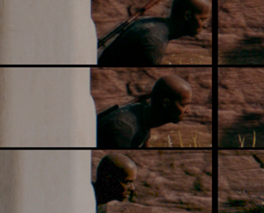
HIGH FRAMES Unlock Gamer Skill
For All Competitive Shooters
Easier Target Tracking
Smoother Animations
Reduced Distracting Effects
Less Ghosting and Tearing
See Players Earlier
Lower System Latency
Overwatch: https://youtu.be/2J-_vCO_Bwc | CS:GO: https://youtu.be/uJxxCgKa0mU | PUBG: <Coming Soon>
Notes:
Why go higher? What does High Frames do for competitive gamers?
Over the last couple years we have studied the benefits of high frames and have found many advantages. High Frames gives you: smoother animation which aids in easier target tracking, less ghosting and tearing which reduces distracting effects, and lower system latency which allows you to see a more “up-to-date” version of the game. With 360Hz, we continue to see these benefits – but don’t just take our word for it.

Slide 7
HIGH FRAMES Unlock Gamer Skill
“ When I switched between 240 and 360, I could immediately tell there was a difference.
This display is great for gamers who want to maximize their potential.”
Jordan n0thing Gilbert,
5-time CS:GO Champion
60Hz/FPS
100ms
120Hz/FPS
54.7ms
240Hz/FPS
34.5ms
360Hz/FPS
20ms
Note: End to End System Latency measured at corresponding FPS/Hz values in Overwatch. Source: NVIDIA Research (See backup for more information)
N0thing’s quotes from: https://youtu.be/wT8oK_pEpd8
Notes:
For years, we have been researching how high Frames gives players the ability to hit their shots. Based on a study that we published at SIGGRAPH Asia in 2019, we found that as Frames increase and latency decreases, the motion perception loop is shortened – leading to better results in aiming tasks. This chart shows that as our frames get higher, we see the relative improvement in flick shot aiming tasks compared to 60FPS/Hz.
For reference, in the 2016 Summer Olympics, the difference between Gold and Silver in the 100 and 200 meter dashes for both men and women was 1%.
Since this display is designed for esports and competitive gamers, we brought in 5-time CS:GO champion Jordan n0thing Gilbert to put the display through its paces. Immediately he could tell the difference between 240 and 360Hz and recommended the display for anyone looking to maximize their potential.

Slide 8
Frames Win Games
A Strong Correlation
Relative Improvement in K/D Ratio
Frame Per Second (FPS)
Based on Fortnite and PUBG relative Kill/death ratios. Source: NVIDIA
Notes:
GeForce Competitive gamers like to win. So how do we get our competitive GeForce gamers to upgrade the latest GPUs?
There is a strong correlation between FPS well above 60, and higher K/D ratios. K/D ratio is simply your kill to death ratio – many competitive players, especially in BRs like PUBG and Fortnite, use this metric to compare the skills.
In order to power these high framerates, we need great GPUs. But before we get there, let’s try to break down why High FPS gives our competitive gamers the edge they need to win.
Correlation Coefficient of .98

Slide 9
Frames Win Games For All Players
Improved K/D Correlation regardless of Playtime
Frame Per Second (FPS)
Based on Fortnite and PUBG relative Kill/death ratios. Source: NVIDIA
Notes:
It doesn’t matter how much you play, Higher frames correlates to improved K/D.

Slide 10
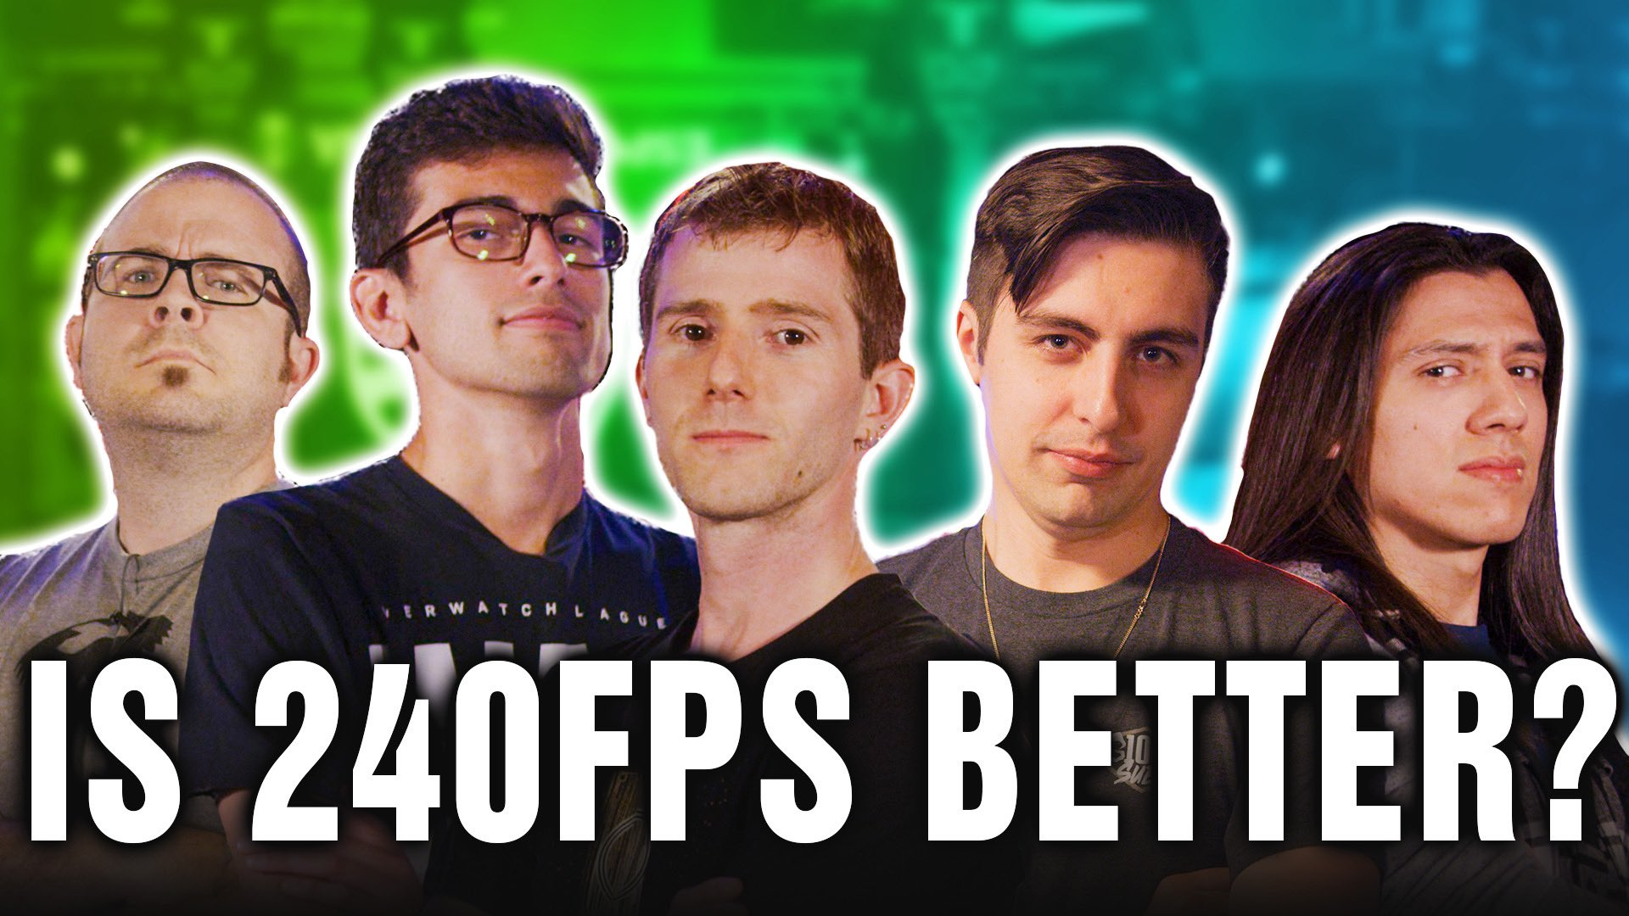
Competitive Gamers: 60 is out — 144+ is in
GPUs Provide Frames that Win Games
“ If you’re not buying a graphics card after watching this video, are you really a gamer?”
Shroud,
Mixer Streamer
“ Will a high FPS and a high refresh monitor make you a great gamer? No. But will it make you a better gamer? Undoubtedly.”
Linus Sebastian,
Linus Tech Tips
Linus Tech Tips | 3.7M Views | 67/1 Like/Dislike Ratio
Source: https://www.youtube.com/watch?v=OX31kZbAXsA&
Notes:
So far, our research into why High FPS gives you the competitive edge has been very well received by some of the industries top influencers.
Linus concluded his video by saying that High FPS will make you a better gamer. Shroud after being part of this video said on his stream that if competitive gamers are not buying a graphics card after seeing this, then are they really a gamer?

Slide 11
Publishers Release Competitive Specs
GeForce RTX 2070 Super
https://support.activision.com/modern-warfare/articles/minimum-and-recommended-system-requirements-for-call-of-duty-modern-warfare-on-pc
GeForce RTX 2060 Super
Link: <Coming Soon>
144+ Frames for Competitive Play
Embargo: 3/24/20
GeForce RTX 2070
https://www.ea.com/games/battlefield/battlefield-5/buy/pc-system-requirements
Notes:
Not only are influencers and gamers believing the High FPS message, publishers are now producing competitive specs targeted at 144FPS as well!

Slide 12
GeForce Delivers the Competitive Edge
144+ FPS Gaming – Battle Royale
240 FPS
144 FPS
Average FPS at 1080p, High settings, with i9-9900K. 144 FPS, 240 FPS, and 360 FPS is the recommended performance to run 144 Hz, 240 Hz , and 360 Hz displays, respectively. Source: NVIDIA.
Notes:
GeForce delivers the frames competitive gamers need to win. For Battle Royale titles, 144+ gaming is delivered by the vast majority of the Turing lineup at all high settings, with the 2080 Super and 2080 Ti providing a 240+ FPS experience for Fortnite and Apex Legends.
The white lines are the typical Hz pairings – ideally you want to be running 240 FPS/Hz

Slide 13
GeForce Delivers the Competitive Edge
240+ FPS Gaming – Competitive Shooters
360 FPS
240 FPS
144 FPS
Average FPS at 1080p, High settings, with i9-9900K. 144 FPS, 240 FPS, and 360 FPS is the recommended performance to run 144 Hz, 240 Hz , and 360 Hz displays, respectively. Source: NVIDIA.
Notes:
For the competitive shooters, GeForce means 240+ FPS gaming – reaping the full benefits that we described here today.
Getting a 240+ experience is available on the 2070 Super for all competitive shooters at high settings – GeForce is pretty awesome and truly deliver the competitive edge.

Slide 14
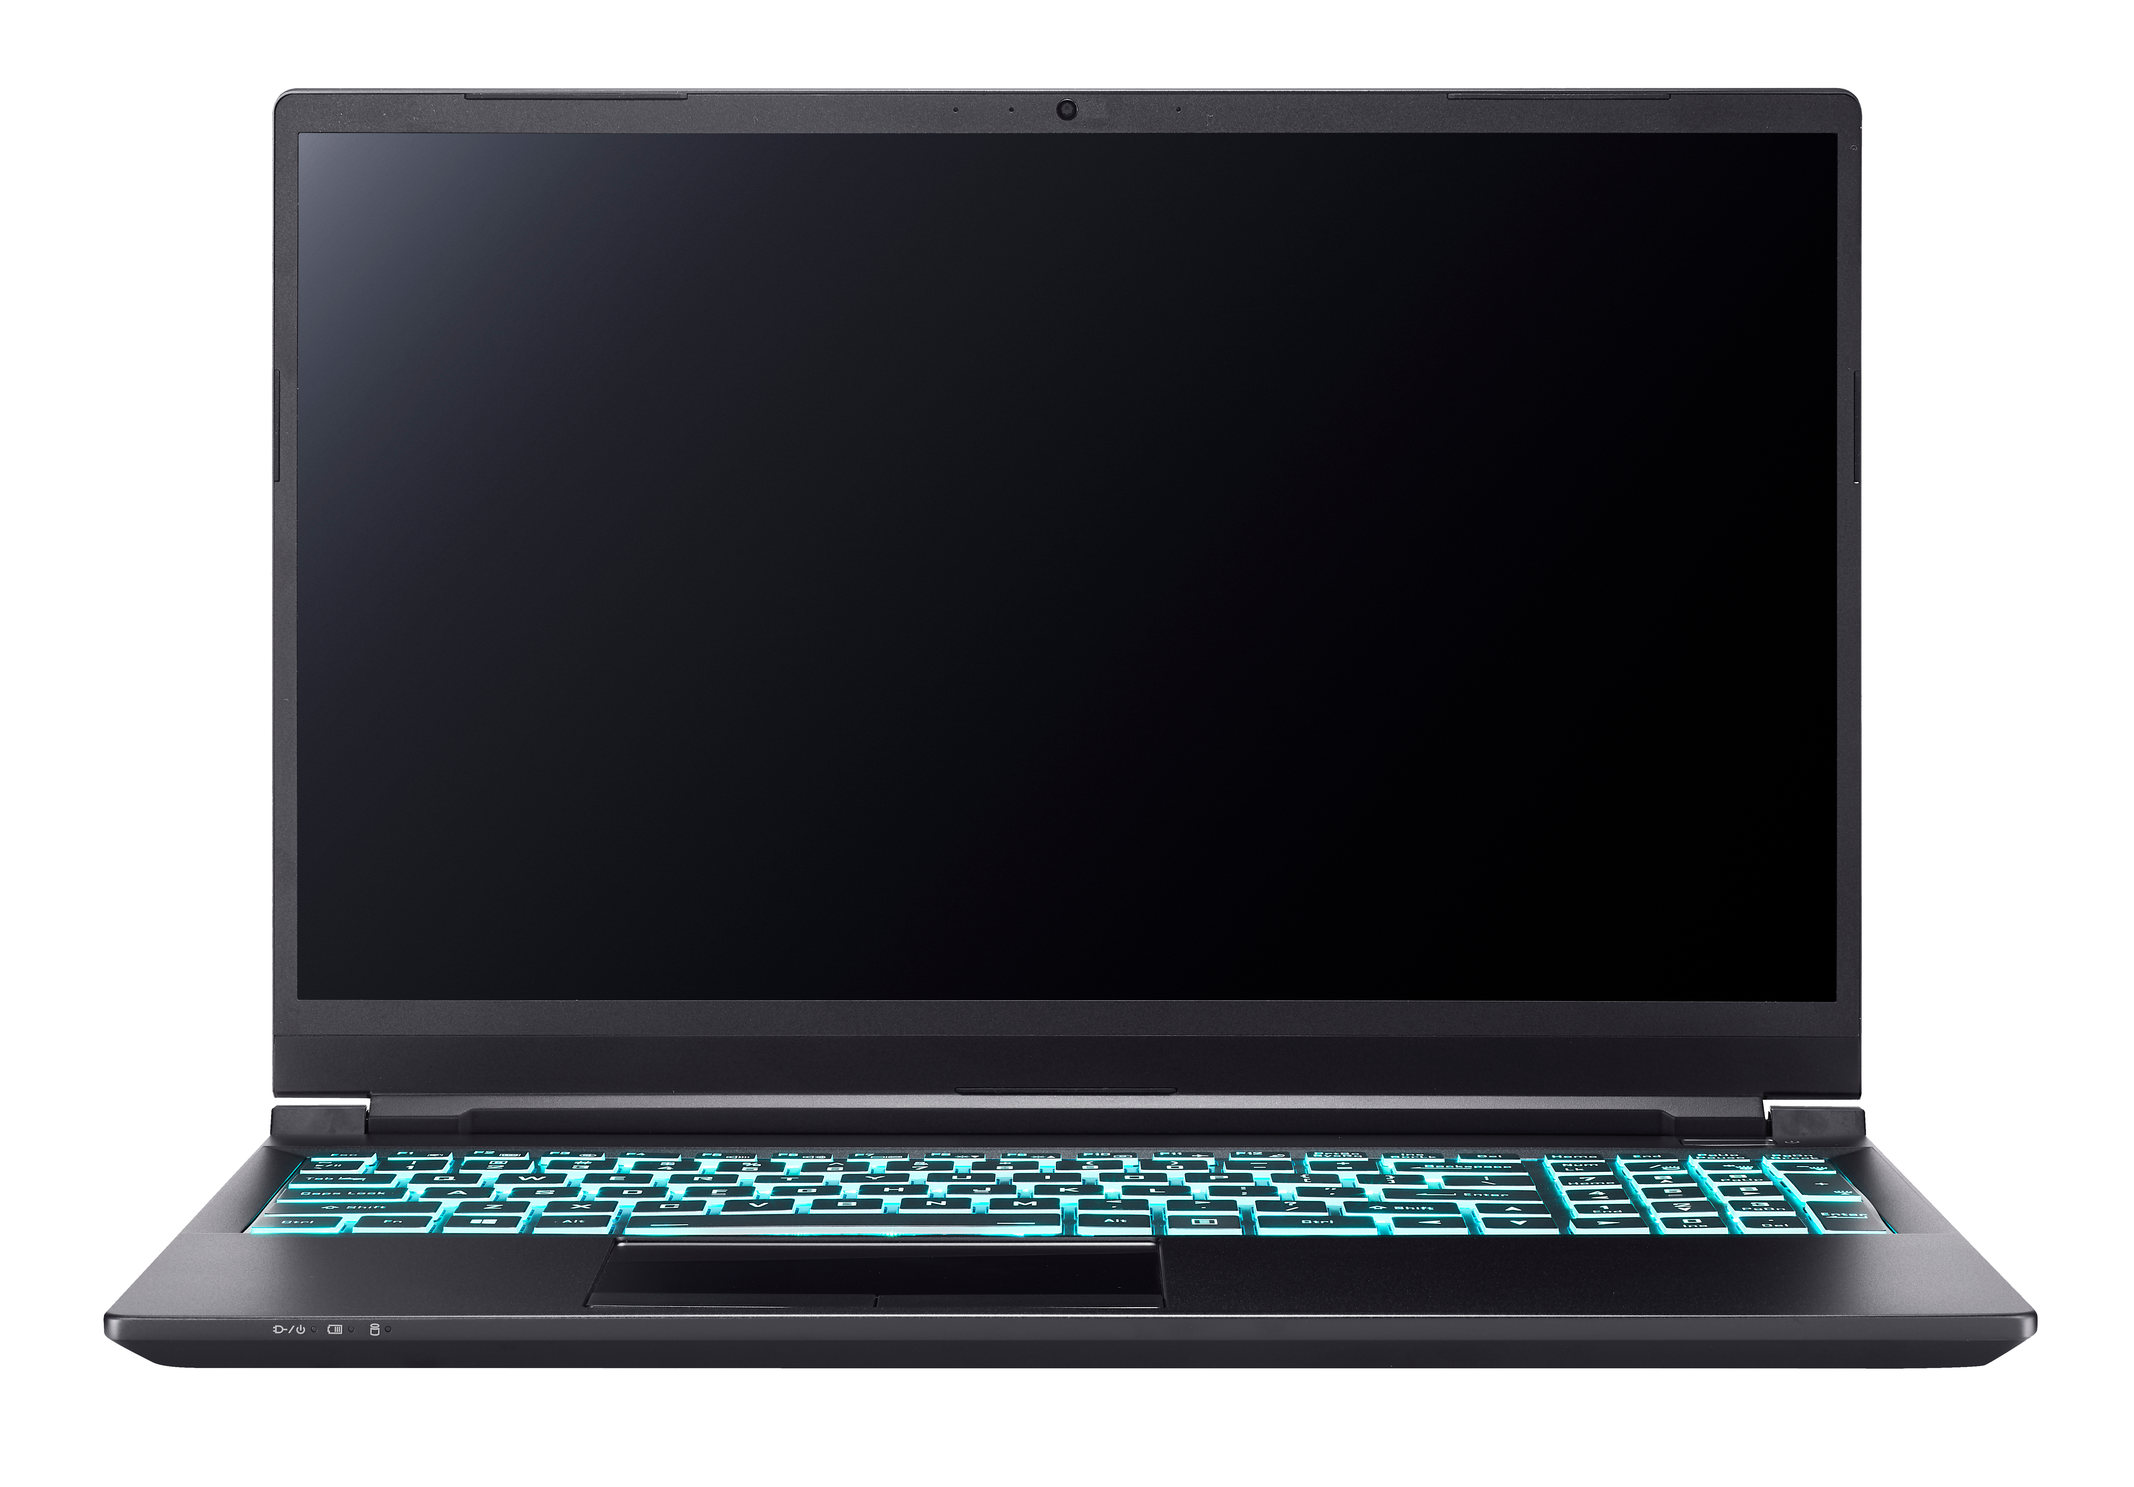
RTX Gaming Laptops are ESPORTS Ready
RTX GPUs Deliver Esports Ready Performance!
300 FPS
100%
240 FPS
OF RTX REFRESH GAMING LAPTOPS HAVE
144Hz+ REFRESH RATE DISPLAYS
144 FPS
Average FPS at 1080p, Esports High settings (mix of High and Low), i7 10750H. 144 FPS, 240 FPS, and 300 FPS is the recommended performance to run 144 Hz, 240 Hz, and 300 Hz displays, respectively.

Slide 15
Call of Duty: Warzone
A New Battle Royale Approaches
144 FPS
Average FPS at 1080p, High settings, with i9-9900K. 144 FPS is the recommended performance to run 144 Hz displays. Source: NVIDIA.
Notes:
COD: Warzone is a new contender in the Battle Royale market – 150 player mayhem, teams of three, and highly competitive. GeForce Delivers the performance needed in this new title! 144+ FPS gaming with a 2060 Super and up.

Slide 16
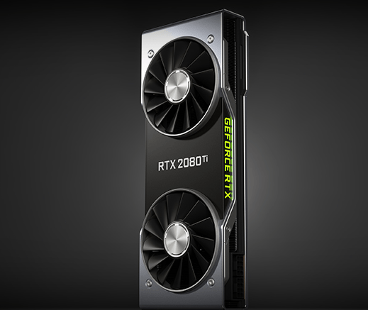
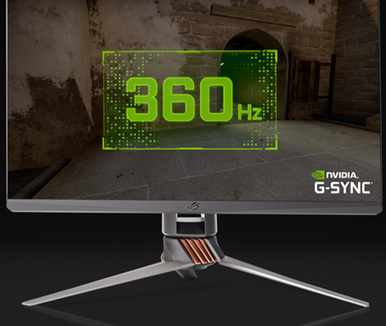
Frames Win Games
GEFORCE Delivers High Frames Gaming
Strong Correlation Frames Win Games
Esports Ready GeForce GPUs
Breakthrough 360Hz G-SYNC Displays
Notes:
Conclusion:
Strong correlation backed by published research that High Frames win Games.
Esports Ready GeForce GPUs give us the FPS we need
Breakthrough 360Hz display push the Esports industry forward

Slide 17
Non-Embargo Alternates

Slide 18
Publishers Release Competitive Specs
GeForce RTX 2070 Super
https://support.activision.com/modern-warfare/articles/minimum-and-recommended-system-requirements-for-call-of-duty-modern-warfare-on-pc
GeForce RTX 2070 Super
https://support.activision.com/warzone/articles/minimum-and-recommended-system-requirements-for-call-of-duty-warzone-on-pc
144+ Frames for Competitive Play
GeForce RTX 2070
https://www.ea.com/games/battlefield/battlefield-5/buy/pc-system-requirements
Notes:
Give folks the links to the publisher specs
Put non-nvidia link on the slide

